Slide 1
Fitness us Practice module group 4
fItneSS us platform is an innovative fitness app designed to provide personalized workout site recommendations, offers tailored workout plans and live form correction during workouts. Additionally, fItneSS us incorporates social media features.

Slide 2

Practice module group 4
Xia Yichao – A0297377H
Huang Tianle- A0296702Y
Huang Chenyu - A0295813W
Zhu Yihang - A0297220H
Group Members

Slide 3
agenda
Project objectives
Project scope
Data available & Technical approach
What we have done so far
agenda
Notes:
We will go through these parts

Slide 4
Project Objectives
To develop a comprehensive fitness platform that offers gym suggestions, personalized workout recommendations, real-time exercise form feedback, and a social community feature for users to share progress and connect with fitness coaches.
Project Objectives

Slide 5
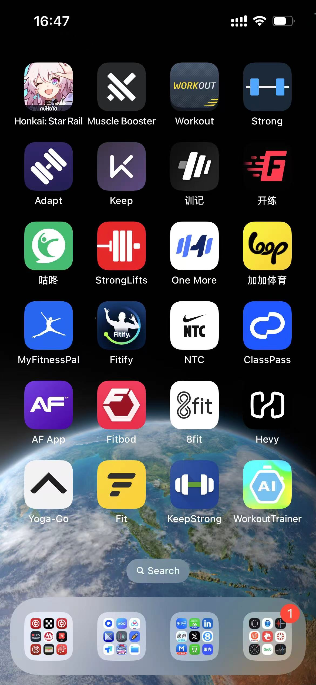
Market analysis
We have reviewed dozens of popular health-care & fitness apps in the app store.
Project Objectives
Notes:
The global fitness industry is projected to grow to over $96 billion by 2024. With the rise of digital fitness solutions due to the COVID-19 pandemic, users are increasingly seeking out home-based fitness platforms with a personalized touch

Slide 6
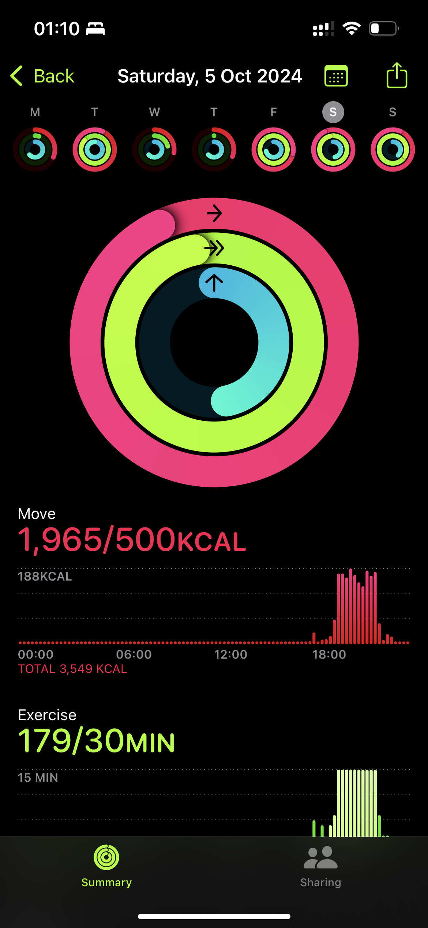
Market analysis
We have reviewed dozens of popular health-care & fitness apps in the app store.
One thing in common: all these apps have a summary feature that shows the user’s fitness history.
Project Objectives

Slide 7
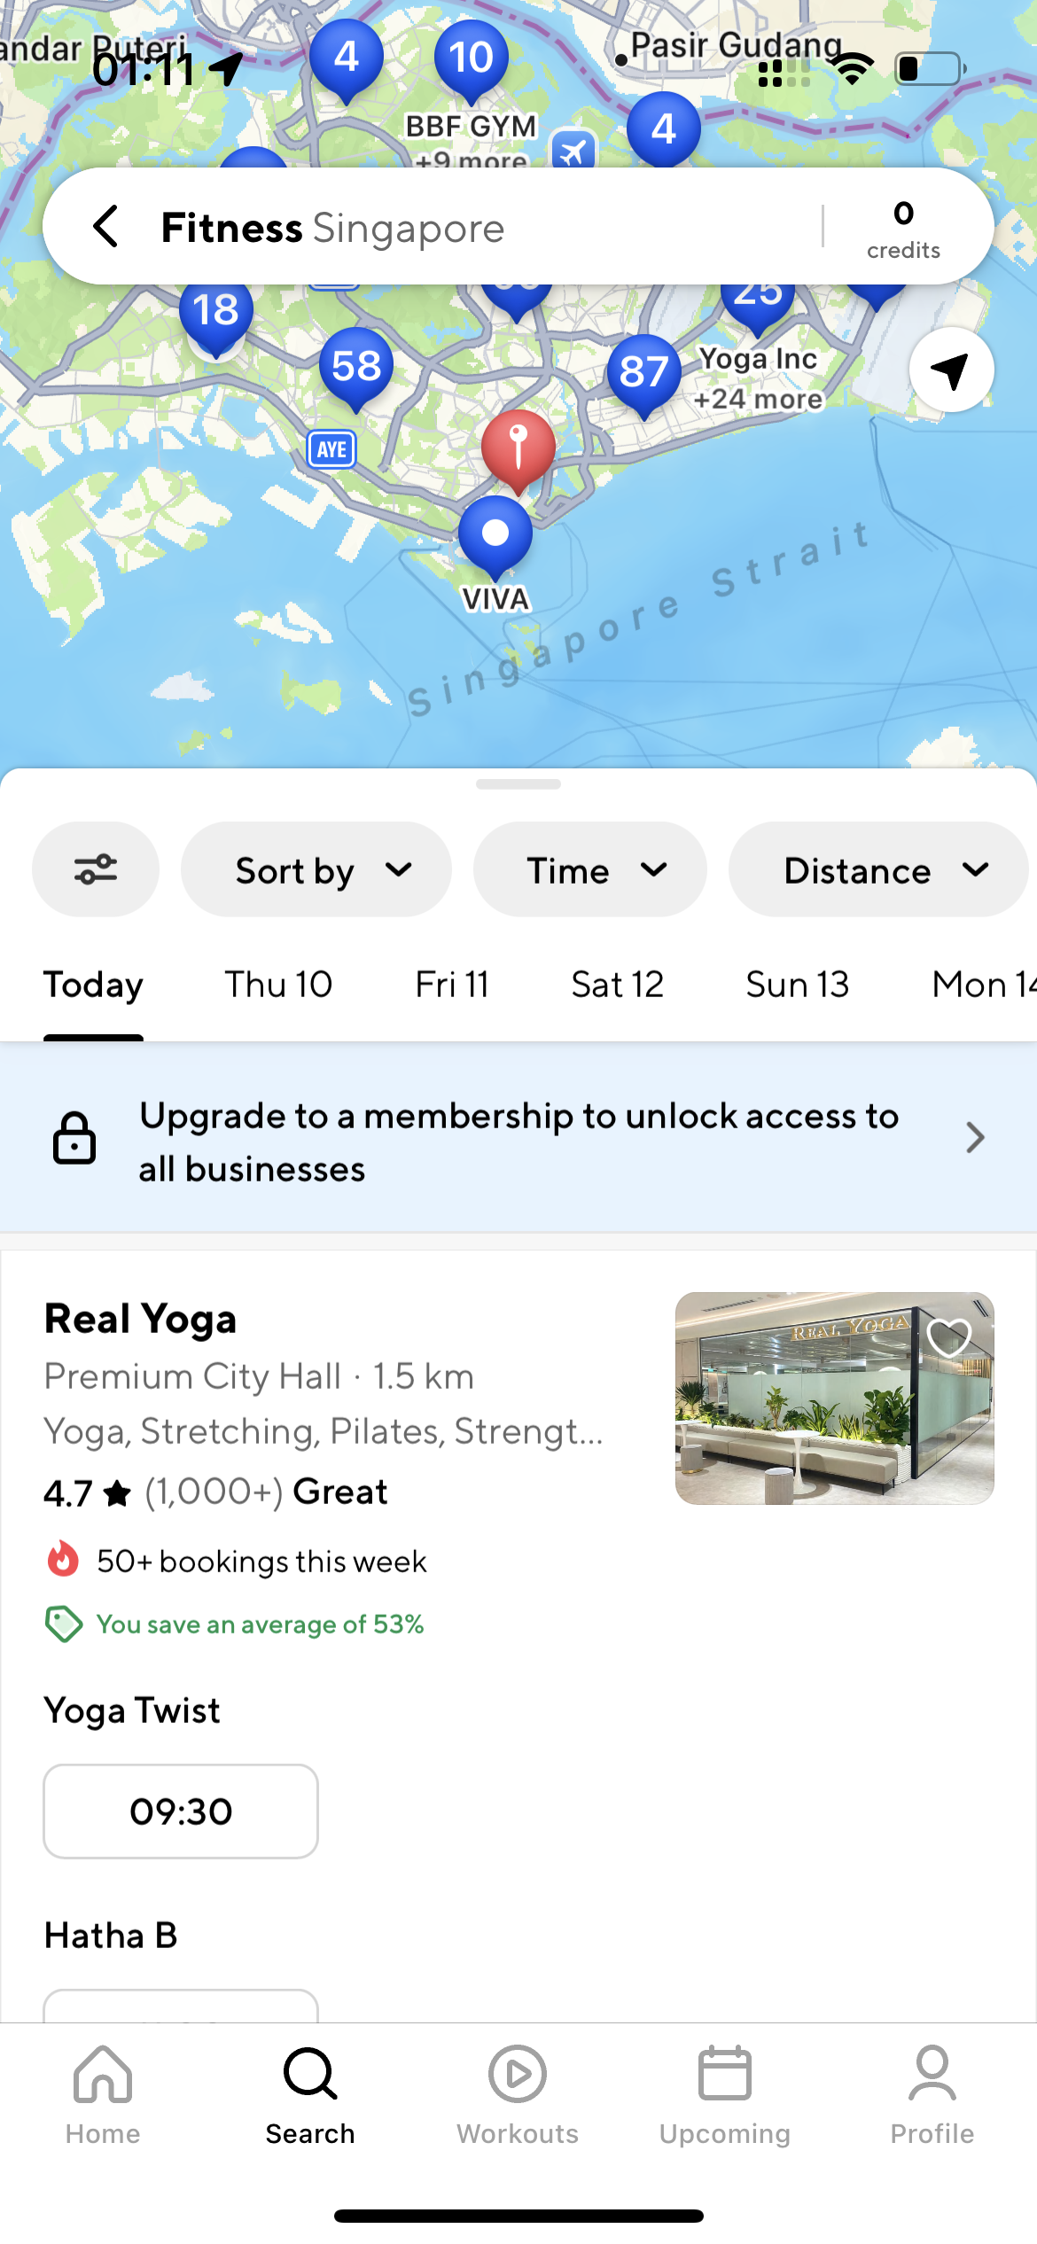
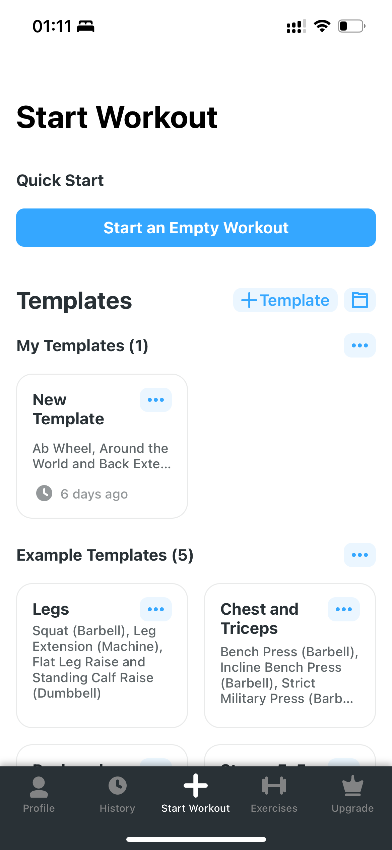
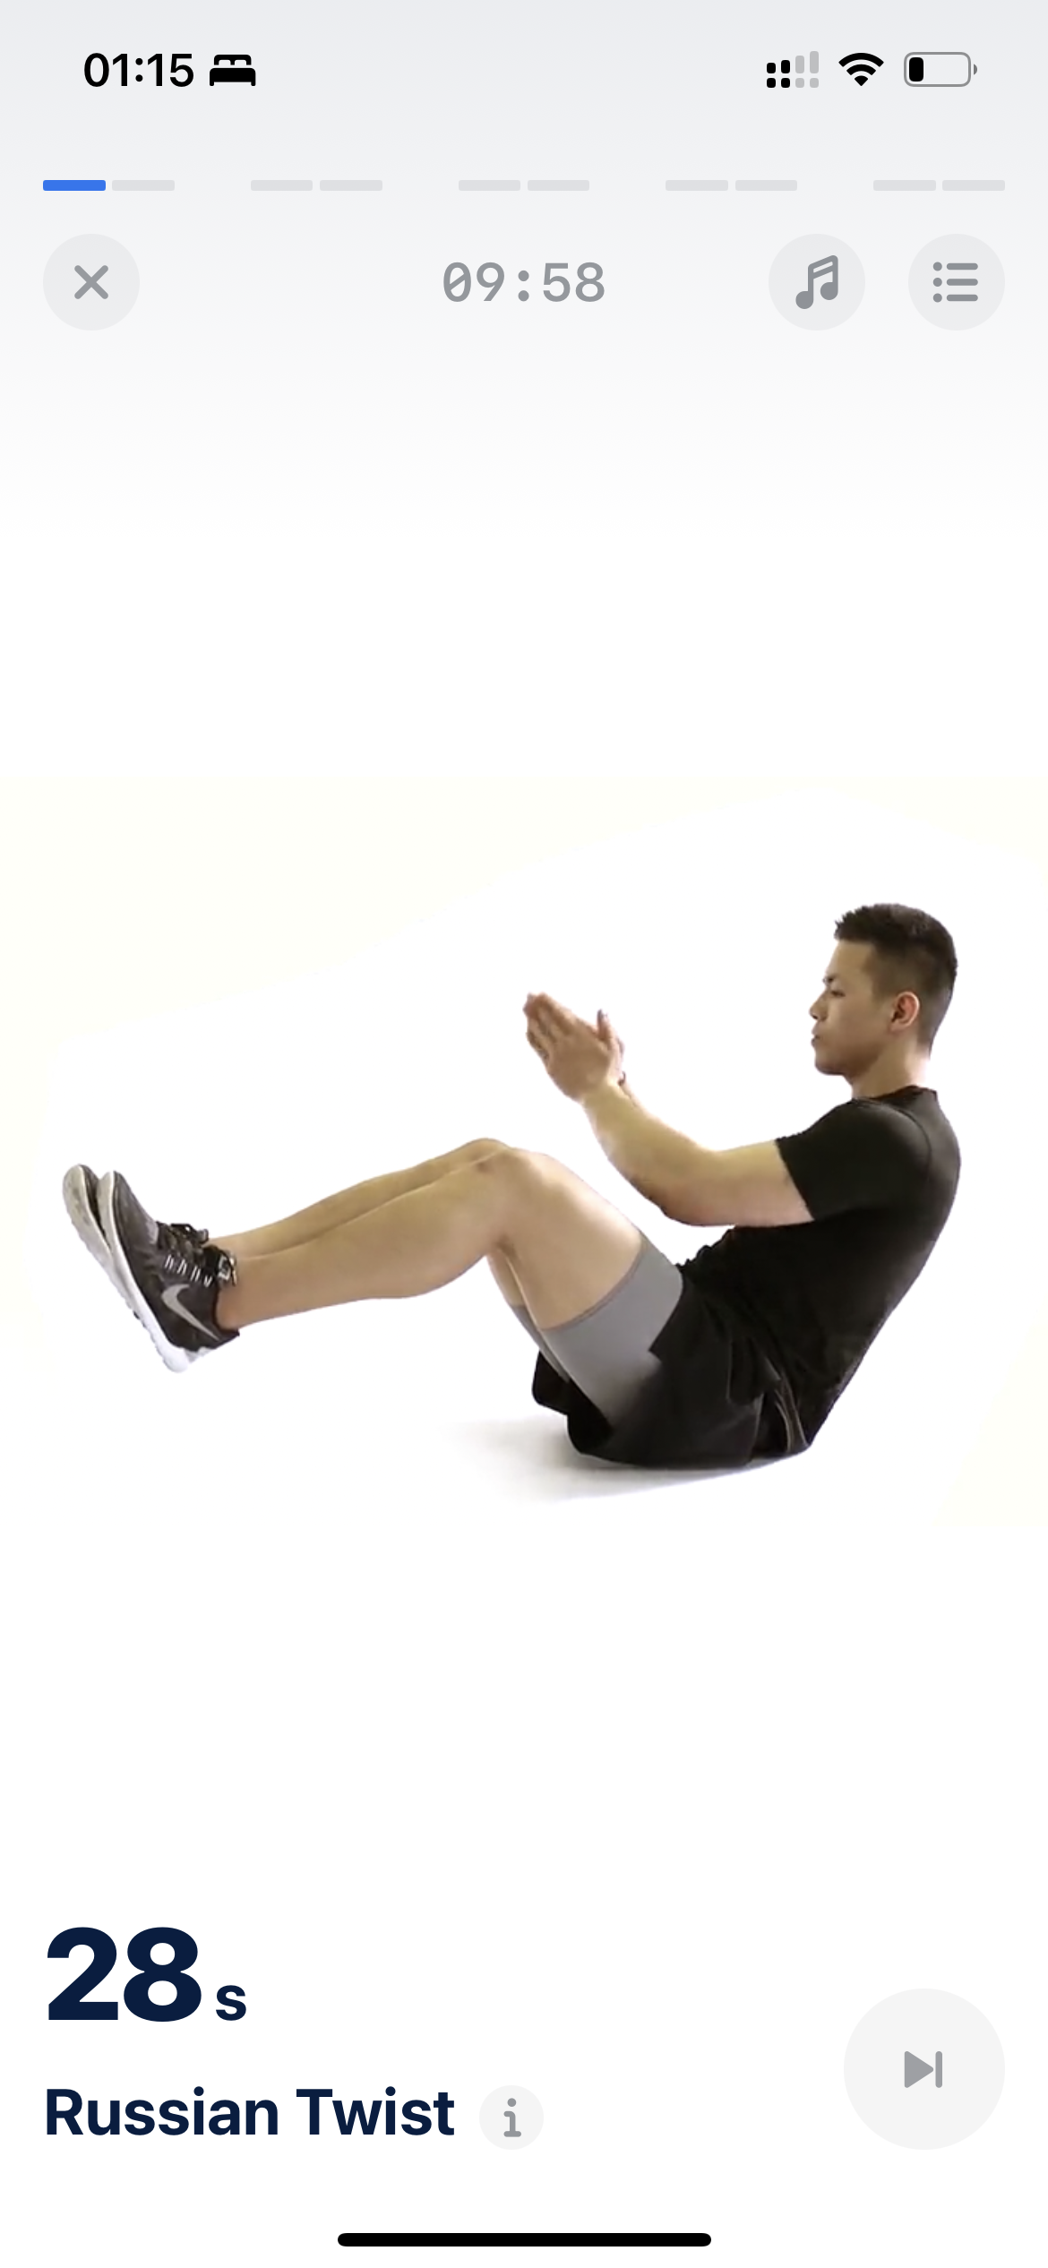
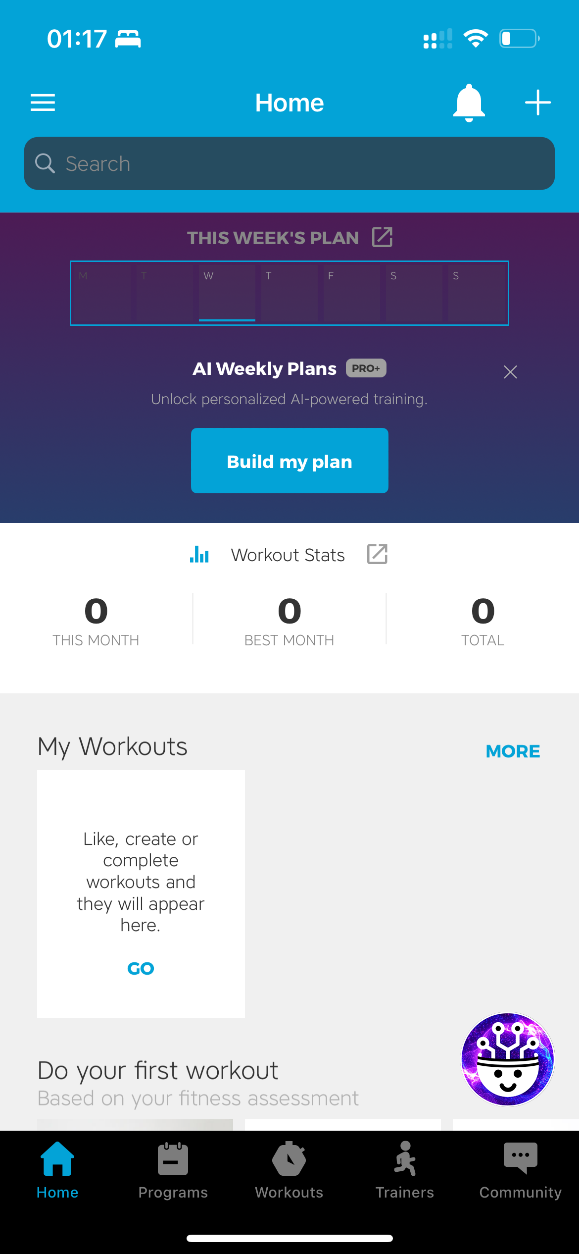
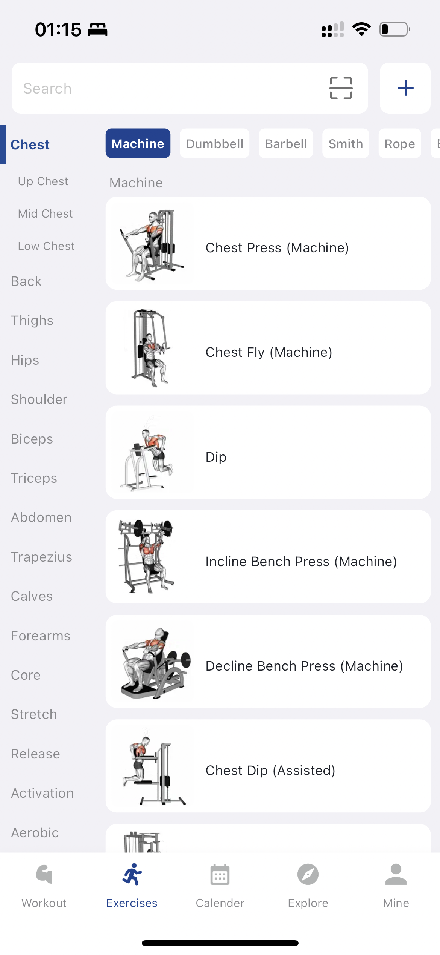
Market analysis
Project Objectives
Notes:
Many existing platforms either focus on location-based services or provide generic workout plans without addressing individual needs

Slide 8
Market analysis
One thing in common: all these apps have a
summary feature
Different apps have different features:
fitness locations,
fitness plans,
movement instruction,
socialising, and e-shopping malls.
Project Objectives
Notes:
existing platforms like Peloton, Mirror, and MyFitnessPal lack the combination of location-based gym recommendations, dynamic workout planning, and real-time form feedback. fItneSS us aims to fill this gap by integrating location-based services with AI-powered workout recommendations and live movement supervision to offer a truly personalized fitness experience.

Slide 9
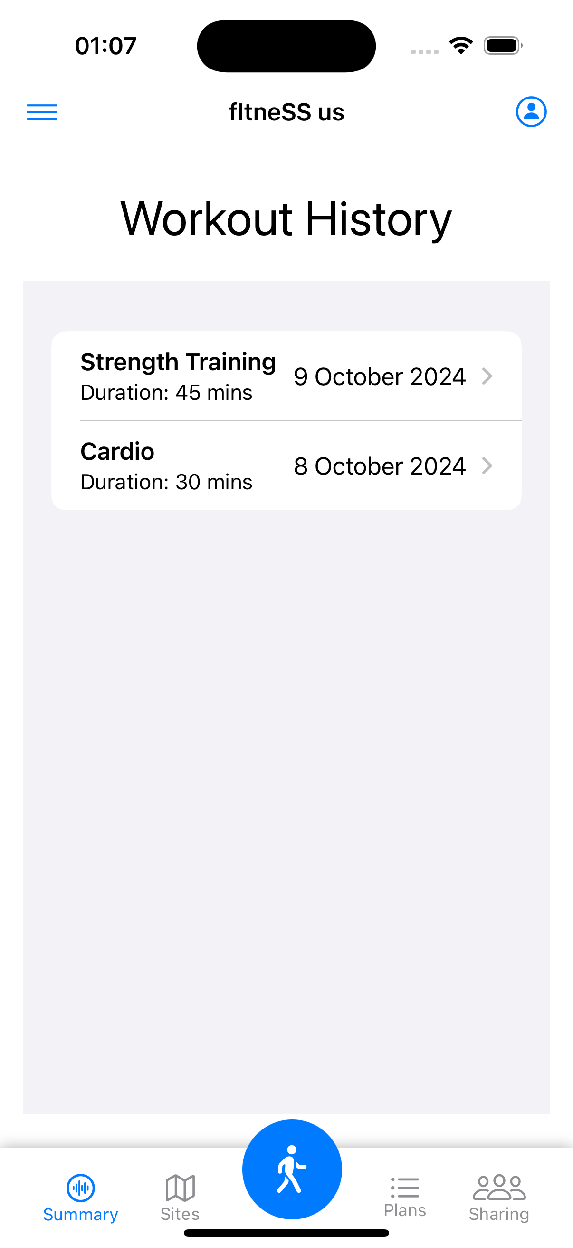
Market analysis
sites
workout
monitor gestures
sharing
blogs
plan
recommend exercises plan
location on map
comments
available time
correction feedback
activities
coaches
Project Objectives
Notes:
fItneSS us aims to fill this gap by integrating location-based services with AI-powered workout recommendations and live movement supervision to offer a truly personalized fitness experience.

Slide 10
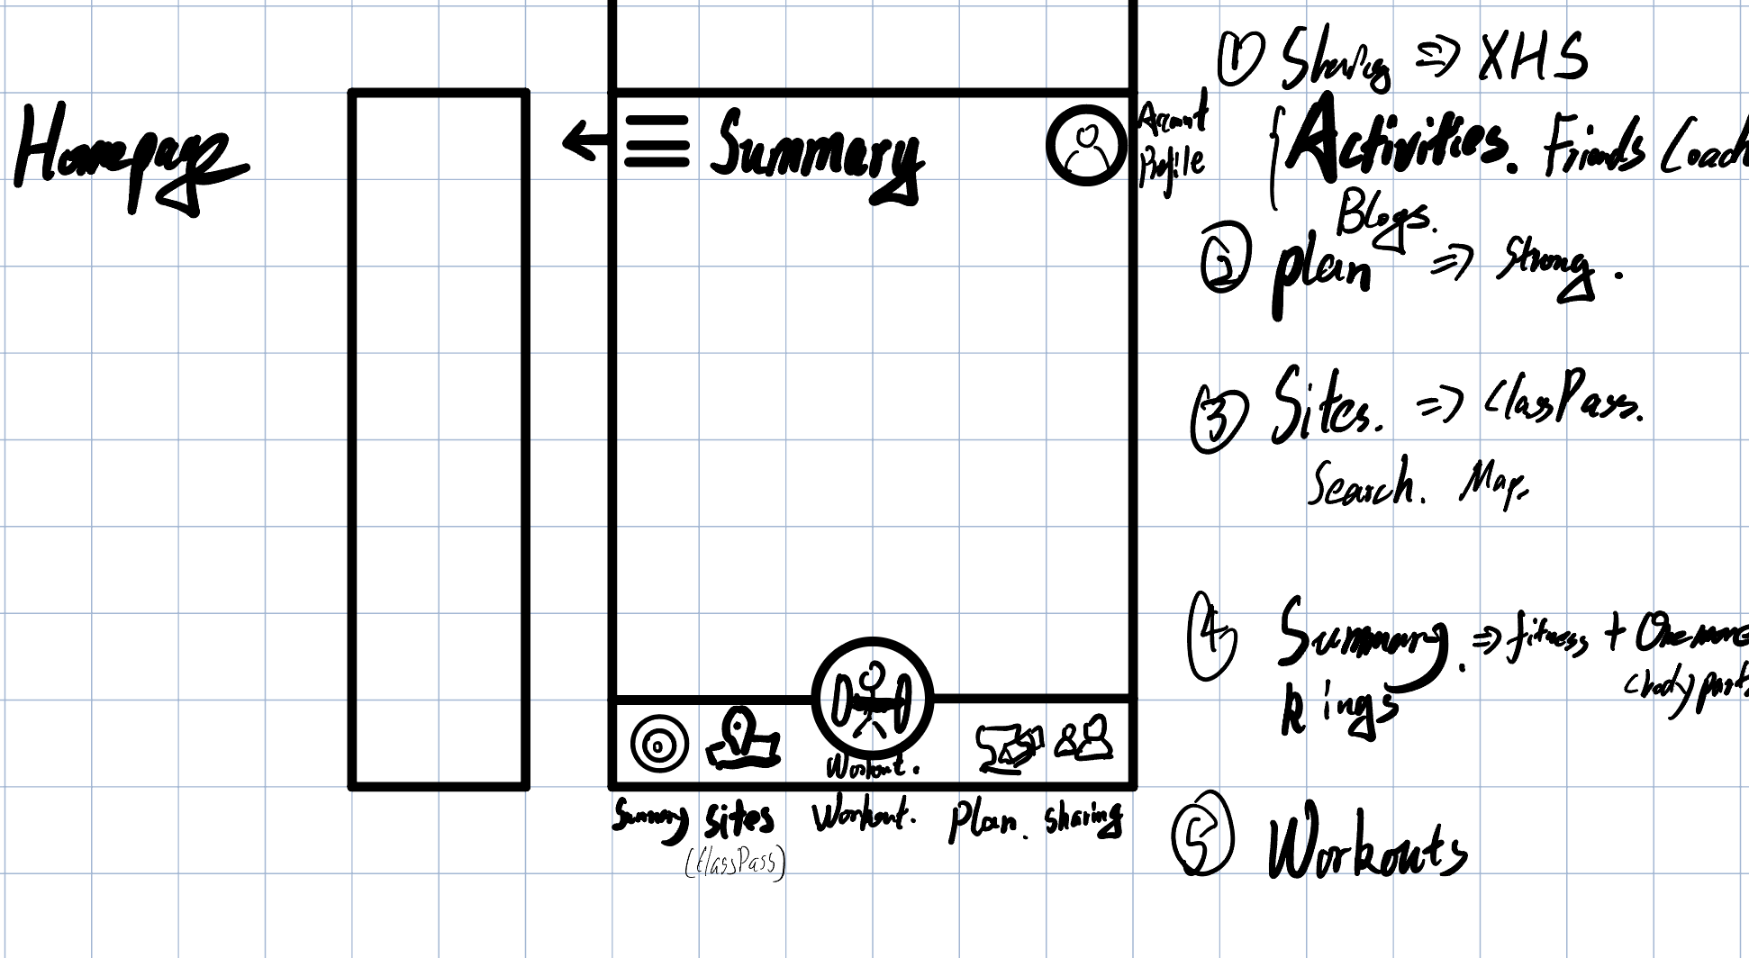
Project scope
Project scope
Notes:
Platform: Targeting iOS with plans to expand to other platforms in the future.

Slide 11
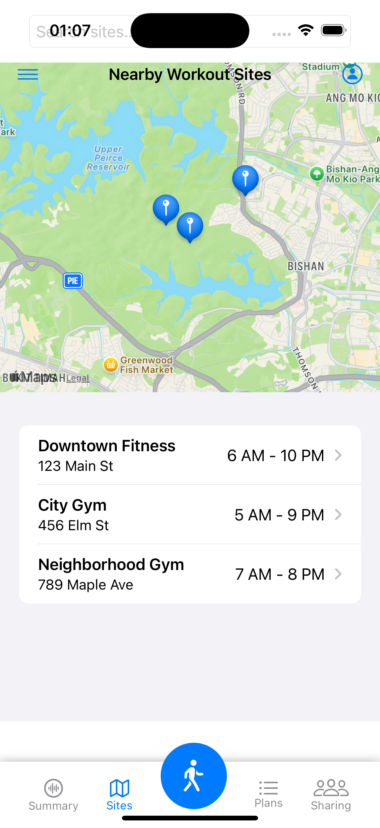
Sites
Location-Based Services:
Location-based Suggestions: Integrate Google Maps or other geo-location APIs to suggest nearby gyms, fitness parks, or workout classes.
Equipment availability
Time Availability
Additional Filters
Project scope
Notes:
Location-based Suggestions: Integrate Google Maps or other geo-location APIs to suggest nearby gyms, fitness parks, or workout classes.
Time Availability: Allow users to input their available time slots and based on gym operating hours, suggest the best matches.
Additional Filters: Add filters like gym amenities, membership type, or class availability.

Slide 12
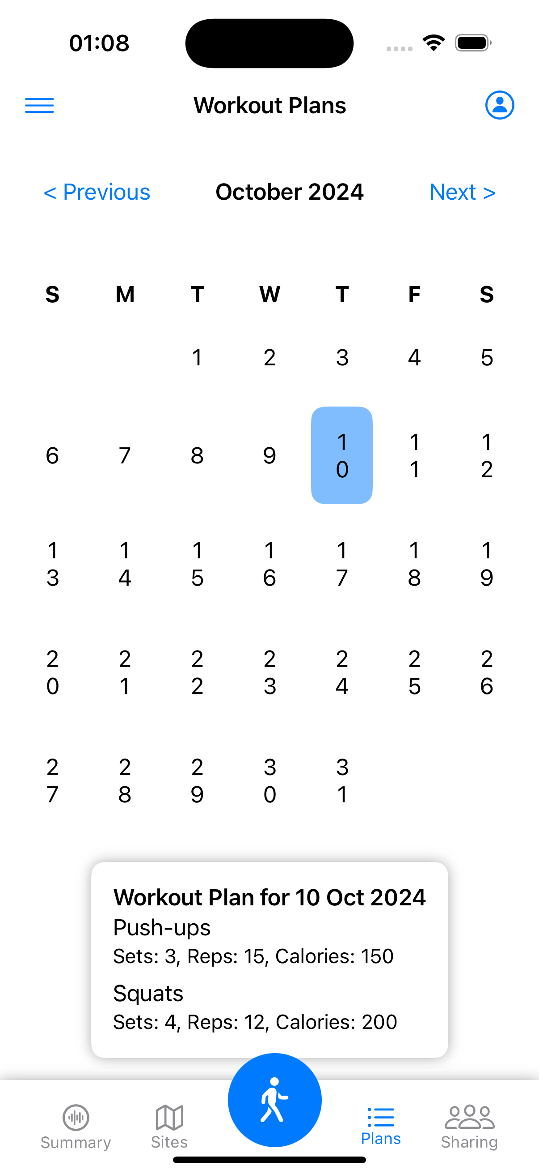
plans
AI-based recommendations on exercise plan
Previous Workouts
Body Status
Goals
Variety
Project scope
Notes:
Previous Workouts: Track users’ previous exercises, sets, and reps to suggest progressive workout routines.
Body Status: Integrate data from fitness trackers (Apple Watch) to understand real-time body metrics like heart rate, recovery, or fatigue levels.
Goals: Let users set fitness goals (weight loss) and tailor exercise recommendations to help them reach those goals.
Variety: Suggest different exercises to avoid workout monotony, while keeping within the user’s fitness plan.

Slide 13
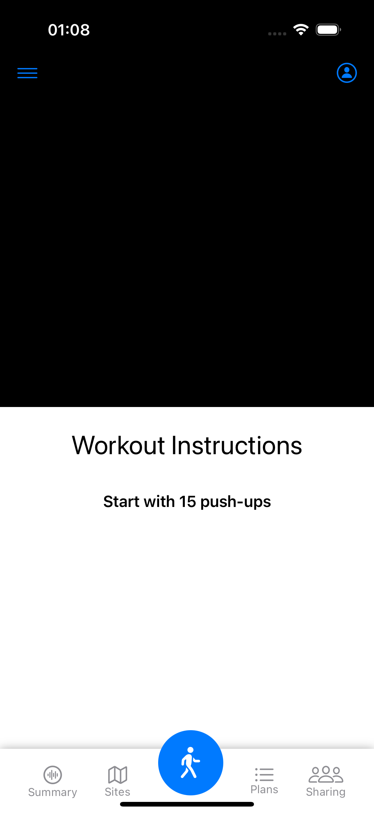
workout
Real-time feedback
Real-time Form Analysis
Forms Feedback
Instructional Guidance
Project scope
Notes:
real-time feedback)
Real-time Form Analysis: Use computer vision and pose estimation algorithms (like Open Pose or Media Pipe) to analyze body posture during workouts.
Forms Feedback: Provide instant feedback on whether users are performing movements correctly or incorrectly.
Instructional Guidance: Offer suggestions to correct form and reduce injury risk. Use voice or visual cues to guide them mid-workout.

Slide 14
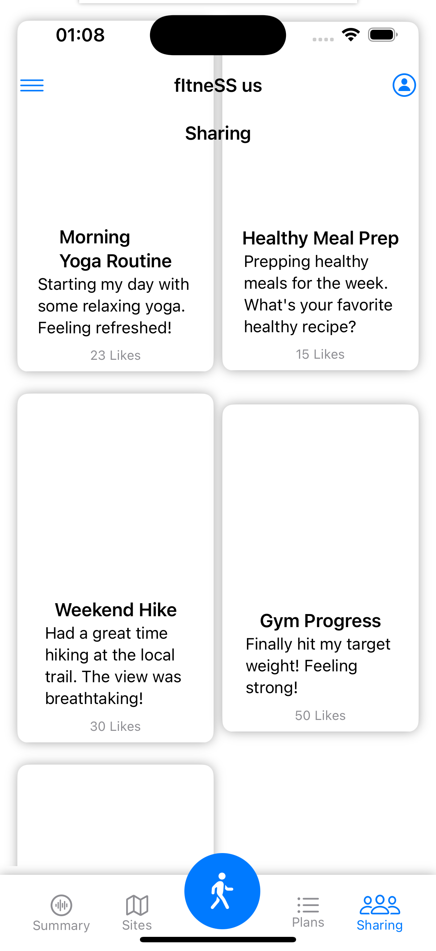
sharing
AI-based recommendations
Enables users to share fitness progress, interact with friends, join fitness challenges, and discover workout inspiration through posts and community engagement, fostering motivation and support within the app.
Posts Recommendation System
Friend Recommendation System
Project scope
Notes:
(AI-based recommendations)
Enables users to share fitness progress, interact with friends, join fitness challenges, and discover workout inspiration through posts and community engagement, fostering motivation and support within the app.
Posts Recommendation System: The post recommendation system will suggest relevant content to users based on their preferences, interests, and interactions. Here are some key considerations:
Friend Recommendation System: The friend recommendation system can be designed to help users connect with others who share similar fitness goals, routines, or live nearby.

Slide 15
Data available & Technical approach
sites
workout
monitor gestures
sharing
blogs
plan
recommend exercises plan
location on map
comments
available time
correction feedback
activities
coaches
Workout Site Recommendation
Personalized Exercise Plan
Movement Supervision & Gesture Correction
Social Media Integration
Data available & Technical approach
Notes:
Here is the data and technical part and we will give it in 4 different functions

Slide 16
Workout Site Recommendation location-based services
Implement location-based suggestions for nearby gyms, fitness parks
Integrate time availability matching with gym operating hours
Develop intelligent recommendation according to distance, gym amenities, comments, history, membership type, and fitness plan
Data available & Technical approach

Slide 17
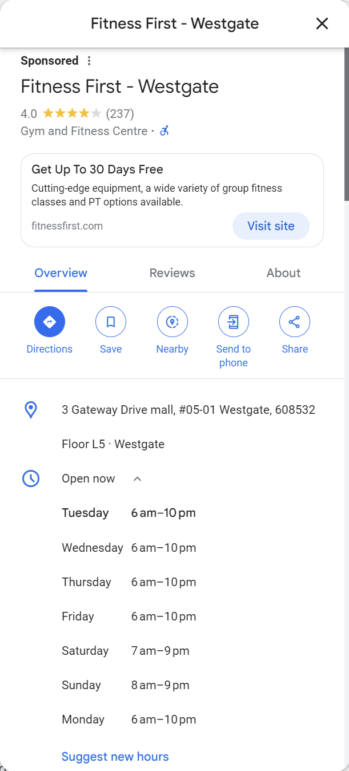
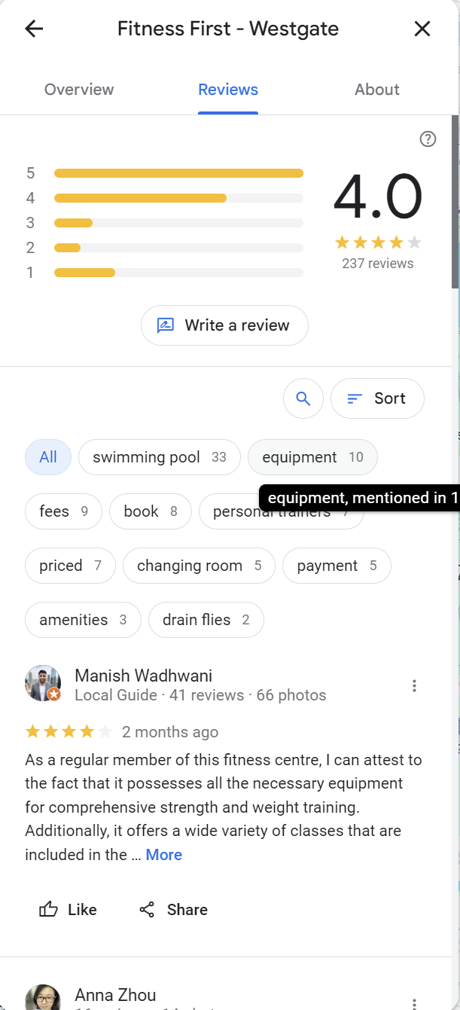
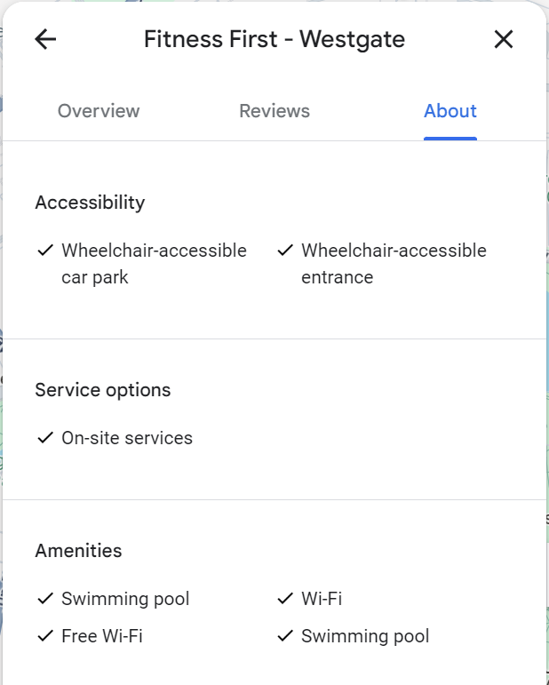
Workout Site Recommendation
Data available & Technical approach
Notes:
The data we need to do this recommendation includes
User's current location (latitude and longitude)
User's available time slots
Gym operating hours (as you can see above)
comments
amenities
and the user’s fitness plan
membership types, class schedules
Preferences, workout history, goals
User profiles, workout logs, social media interactions, gym/site details

Slide 18

Workout Site Recommendation location-based services
How to recommend:
1. Through comments
2. Through visits and histories
3. Through fitness plans
Data available & Technical approach
Notes:
We can get gym reviews from the Google map Places
And by using a sentiment analysis model such as NLTK or Transformers, we can classify reviews as positive, negative, or neutral
And this will be combined with rating (how many stars) and we can get a score of each gym
Then we use this score as a feature for gym ranking

Slide 19
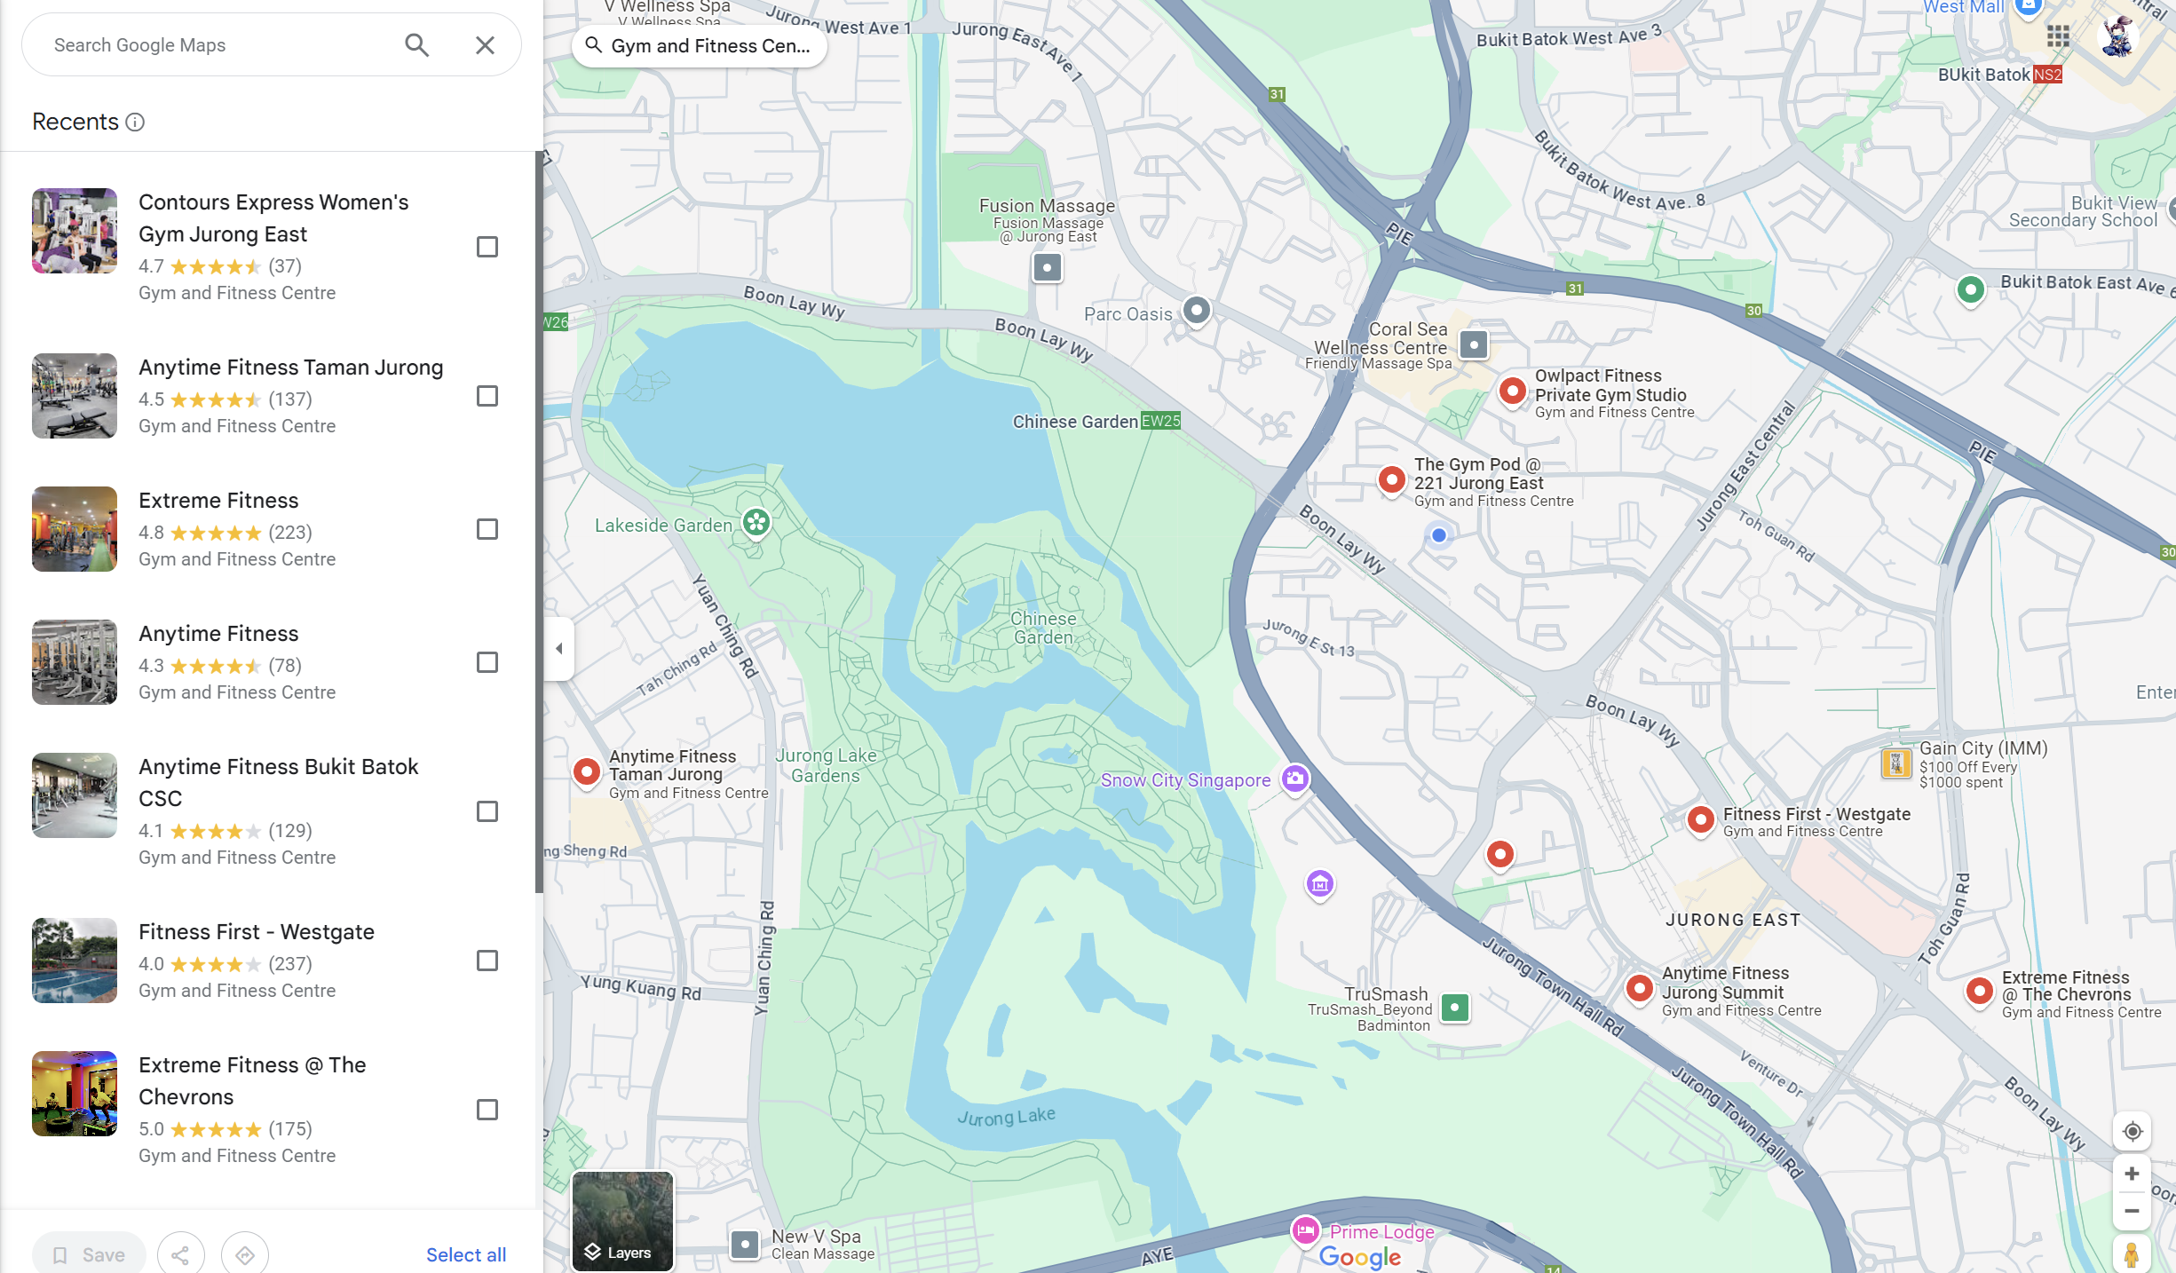
Workout Site Recommendation location-based services
How to recommend:
1. Through comments
2. Through visits and histories
3. Through fitness plans
Data available & Technical approach
Notes:
The software will be able to read a user’s history of gym visits and ratings
And we will create a model that learns from that
Then we will use a collaborative filtering algorithm (e.g., matrix factorization) to predict user preferences for new gyms.

Slide 20
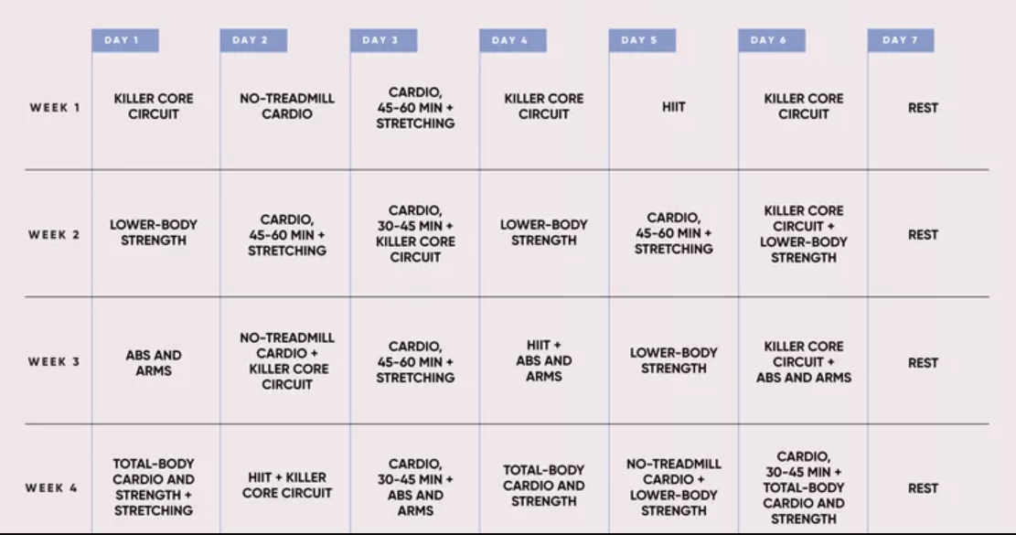
Workout Site Recommendation location-based services
How to recommend:
1. Through comments
2. Through visits and histories
3. Through fitness plans
Data available & Technical approach
Notes:
The third one is analyzing the user's recommended workout plan which will be given by another part of our software
We will create a feature vector for each gym based on its amenities and classes.
and we will match workout plans with gym features
By combining these methods we can build a hybrid recommendation system
We will consider these problems and also distance from the user
And at last we will use unsupervised learning (e.g., K-means clustering) to group similar gyms
And Recommend gyms from clusters that match the user's preferences.

Slide 21
Personalized Exercise Plan AI-based recommendations
exercise a particular body part
weight loss
Data available & Technical approach
Notes:
The training recommendations are mainly based on two parts. The first part is aimed at users with specific goals and plans to exercise a particular body part. In this part, I am using a dataset that contains 2,909 different exercises, along with the corresponding equipment and fitness levels (Beginner, Intermediate, Expert). The dataset also includes some ratings and descriptions, although there are significant amount of missing values, requiring data preprocessing techniques like imputation. For this part, I plan to use a Random Forest model with the goal of predicting a score based on user input, such as their fitness level (e.g., beginner), available equipment, and the body part or type of workout they want to target. Random Forest can effectively manage datasets with many features. In the exercise recommendation system, where user inputs (for example,level, equipment, target body part.) can be varied, Random Forest automatically assesses the importance of each feature and makes reasonable predictions.The model will recommend the top three exercises base on the predicted ratings, and if fewer than three are found, it will appropriately relax the criteria to get enough recommendations.
The second part is set up for the purpose of user weight loss, in this part, the core is a calorie calculator based on the knowledge learned from the dataset according to the user's height, weight, age, and gender 同predict the amount of calories burned per hour at different exercise intensities. The source of the dataset I use is data received from a health center from 15,000 participants aged 20-76. In the dataset, although there is no clear mention of what kind of fitness activity is performed, we can know the intensity of the exercise based on the heart rate and age it provides. In general, 220 minus age is someone's maximum heart rate, and the ratio of current heart rate to maximum heart rate can be defined as exercise intensity. This allows us to recommend common types of exercise at different intensities to give out a more personal workout plan, and to indicate the heart rate that people need to achieve according to their age. Based on this data, I use DNN for model training. Once trained, the model can output calorie burn under some exercise intensity conditions based on the physical condition parameters entered by the user. I also set a daily calorie intake standard of 2000 for men and 1500 for women, and calculated their BMR according to different weight ranges, that is, the calories that would be burned if they did nothing, and the goal of weight loss was to make up for the extra calorie difference by adding extra training to achieve weight loss. At the same time, weight loss is a dynamic process, in general, under the same conditions, the calories consumed will be less as the weight decreases, and the BMR will be less after weight loss, which requires an increase in the amount of training, therefore, this system will also prompt the amount of training that needs to be increased in the case of how much weight is lost, so as to complete a more accurate and personalized weight loss program.

Slide 22
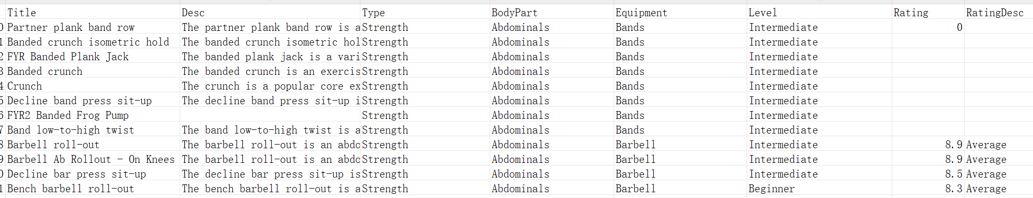
Personalized Exercise Plan AI-based recommendations
Data available & Technical approach
Notes:
The training recommendations are mainly based on two parts. The first part is aimed at users with specific goals and plans to exercise a particular body part. In this part, I am using a dataset that contains 2,909 different exercises, along with the corresponding equipment and fitness levels (Beginner, Intermediate, Expert). The dataset also includes some ratings and descriptions, although there are significant amount of missing values, requiring data preprocessing techniques like imputation. For this part, I plan to use a Random Forest model with the goal of predicting a score based on user input, such as their fitness level (e.g., beginner), available equipment, and the body part or type of workout they want to target. Random Forest can effectively manage datasets with many features. In the exercise recommendation system, where user inputs (for example,level, equipment, target body part.) can be varied, Random Forest automatically assesses the importance of each feature and makes reasonable predictions.The model will recommend the top three exercises base on the predicted ratings, and if fewer than three are found, it will appropriately relax the criteria to get enough recommendations.
The second part is set up for the purpose of user weight loss, in this part, the core is a calorie calculator based on the knowledge learned from the dataset according to the user's height, weight, age, and gender 同predict the amount of calories burned per hour at different exercise intensities. The source of the dataset I use is data received from a health center from 15,000 participants aged 20-76. In the dataset, although there is no clear mention of what kind of fitness activity is performed, we can know the intensity of the exercise based on the heart rate and age it provides. In general, 220 minus age is someone's maximum heart rate, and the ratio of current heart rate to maximum heart rate can be defined as exercise intensity. This allows us to recommend common types of exercise at different intensities to give out a more personal workout plan, and to indicate the heart rate that people need to achieve according to their age. Based on this data, I use DNN for model training. Once trained, the model can output calorie burn under some exercise intensity conditions based on the physical condition parameters entered by the user. I also set a daily calorie intake standard of 2000 for men and 1500 for women, and calculated their BMR according to different weight ranges, that is, the calories that would be burned if they did nothing, and the goal of weight loss was to make up for the extra calorie difference by adding extra training to achieve weight loss. At the same time, weight loss is a dynamic process, in general, under the same conditions, the calories consumed will be less as the weight decreases, and the BMR will be less after weight loss, which requires an increase in the amount of training, therefore, this system will also prompt the amount of training that needs to be increased in the case of how much weight is lost, so as to complete a more accurate and personalized weight loss program.

Slide 23
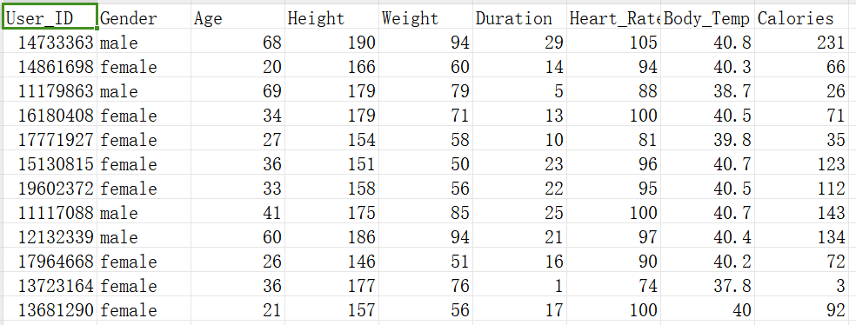
Personalized Exercise Plan AI-based recommendations
Data available & Technical approach
Notes:
The training recommendations are mainly based on two parts. The first part is aimed at users with specific goals and plans to exercise a particular body part. In this part, I am using a dataset that contains 2,909 different exercises, along with the corresponding equipment and fitness levels (Beginner, Intermediate, Expert). The dataset also includes some ratings and descriptions, although there are significant amount of missing values, requiring data preprocessing techniques like imputation. For this part, I plan to use a Random Forest model with the goal of predicting a score based on user input, such as their fitness level (e.g., beginner), available equipment, and the body part or type of workout they want to target. Random Forest can effectively manage datasets with many features. In the exercise recommendation system, where user inputs (for example,level, equipment, target body part.) can be varied, Random Forest automatically assesses the importance of each feature and makes reasonable predictions.The model will recommend the top three exercises base on the predicted ratings, and if fewer than three are found, it will appropriately relax the criteria to get enough recommendations.
The second part is set up for the purpose of user weight loss, in this part, the core is a calorie calculator based on the knowledge learned from the dataset according to the user's height, weight, age, and gender 同predict the amount of calories burned per hour at different exercise intensities. The source of the dataset I use is data received from a health center from 15,000 participants aged 20-76. In the dataset, although there is no clear mention of what kind of fitness activity is performed, we can know the intensity of the exercise based on the heart rate and age it provides. In general, 220 minus age is someone's maximum heart rate, and the ratio of current heart rate to maximum heart rate can be defined as exercise intensity. This allows us to recommend common types of exercise at different intensities to give out a more personal workout plan, and to indicate the heart rate that people need to achieve according to their age. Based on this data, I use DNN for model training. Once trained, the model can output calorie burn under some exercise intensity conditions based on the physical condition parameters entered by the user. I also set a daily calorie intake standard of 2000 for men and 1500 for women, and calculated their BMR according to different weight ranges, that is, the calories that would be burned if they did nothing, and the goal of weight loss was to make up for the extra calorie difference by adding extra training to achieve weight loss. At the same time, weight loss is a dynamic process, in general, under the same conditions, the calories consumed will be less as the weight decreases, and the BMR will be less after weight loss, which requires an increase in the amount of training, therefore, this system will also prompt the amount of training that needs to be increased in the case of how much weight is lost, so as to complete a more accurate and personalized weight loss program.

Slide 24
Movement Supervision & Gesture Correction
Objective
Classification of Fitness Postures
Judgment of whether the fitness posture is standard or not.
Voice Error Correction
Data available & Technical approach

Slide 25
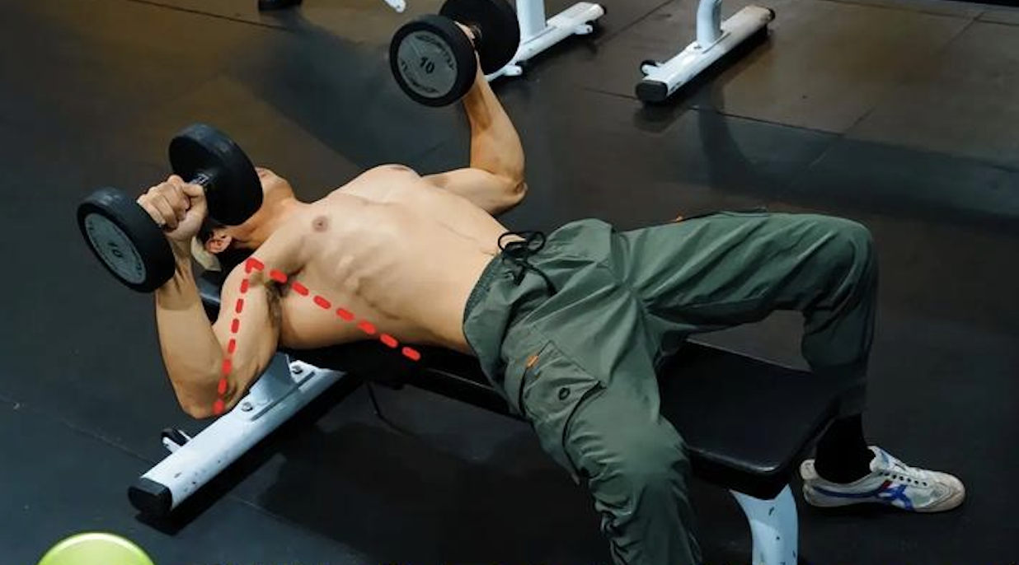
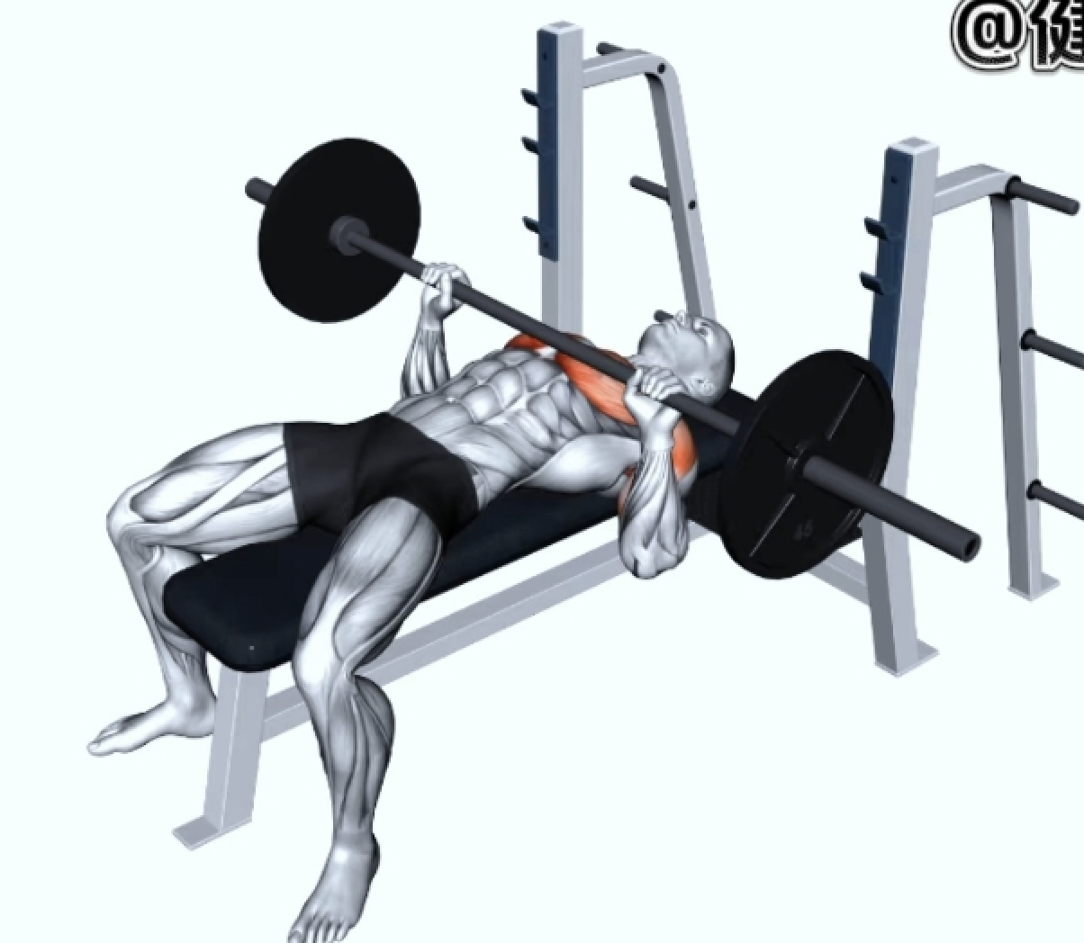
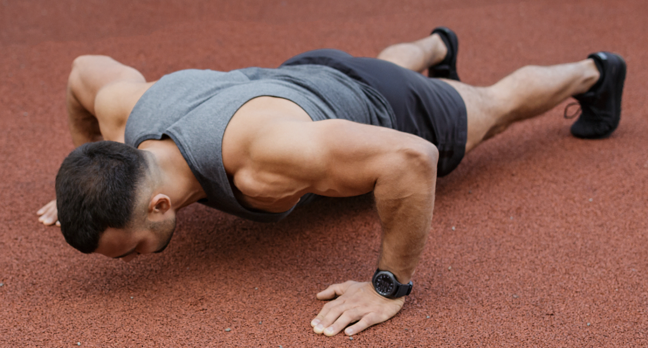
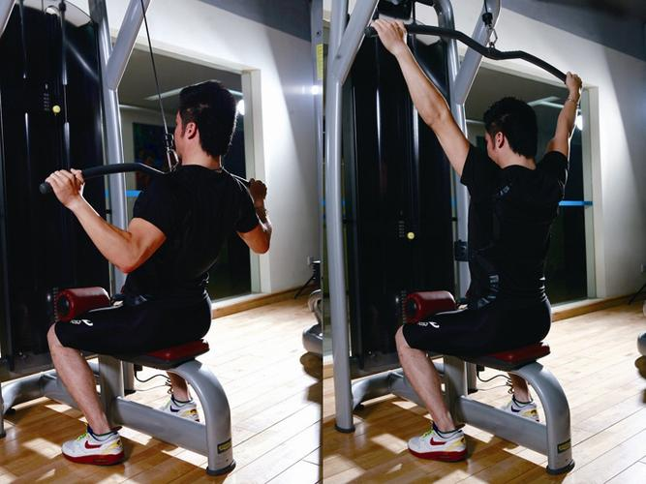
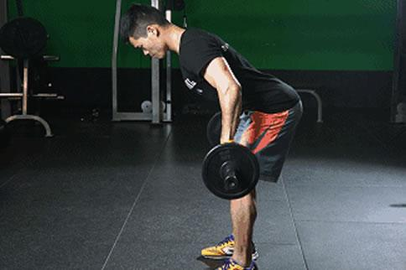
Movement Supervision & Gesture Correction
1.Dumbbell Flat Bench Press
2.Barbell Bench Press
3.Push-up
4.Bent-over Barbell Row
5.Wide-Grip Lat Pulldown
Data available & Technical approach

Slide 26
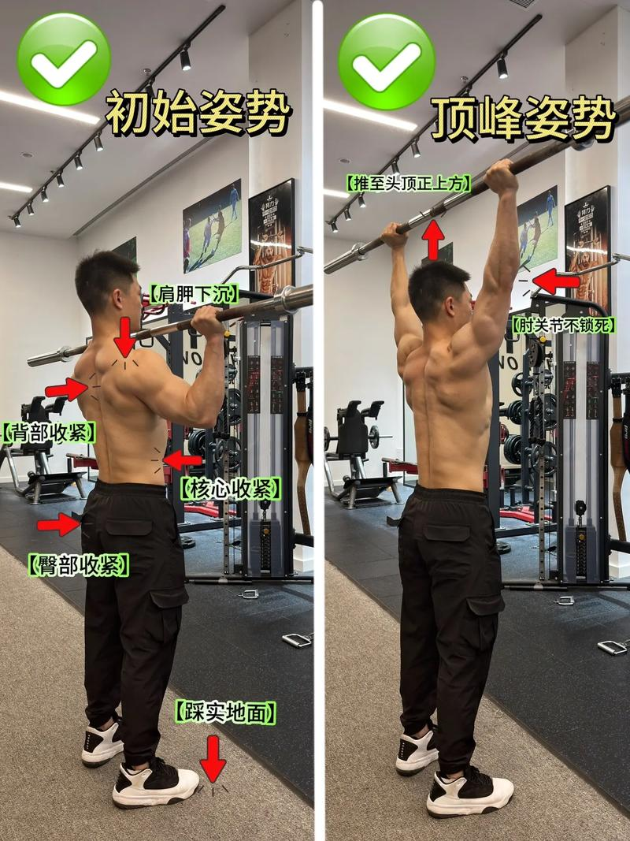
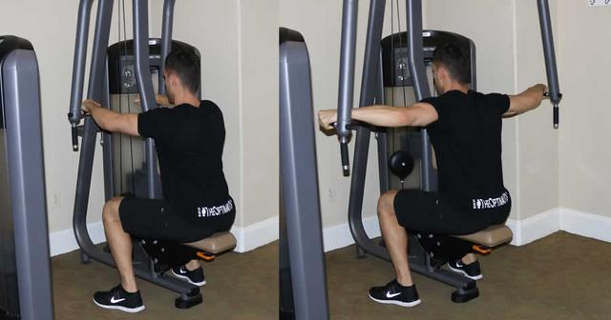
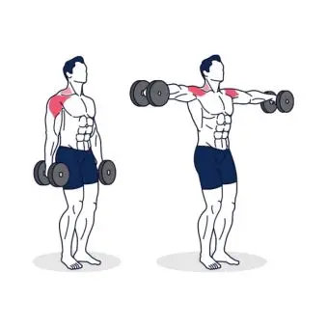
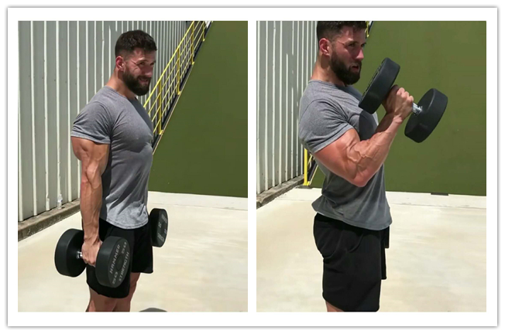

Movement Supervision & Gesture Correction
6.Reverse Pec Deck Machine
7. Lateral Raise
8.Standing Barbell Shoulder Press
9.Barbell Bicep Curl
10. Pull-up
Data available & Technical approach

Slide 27
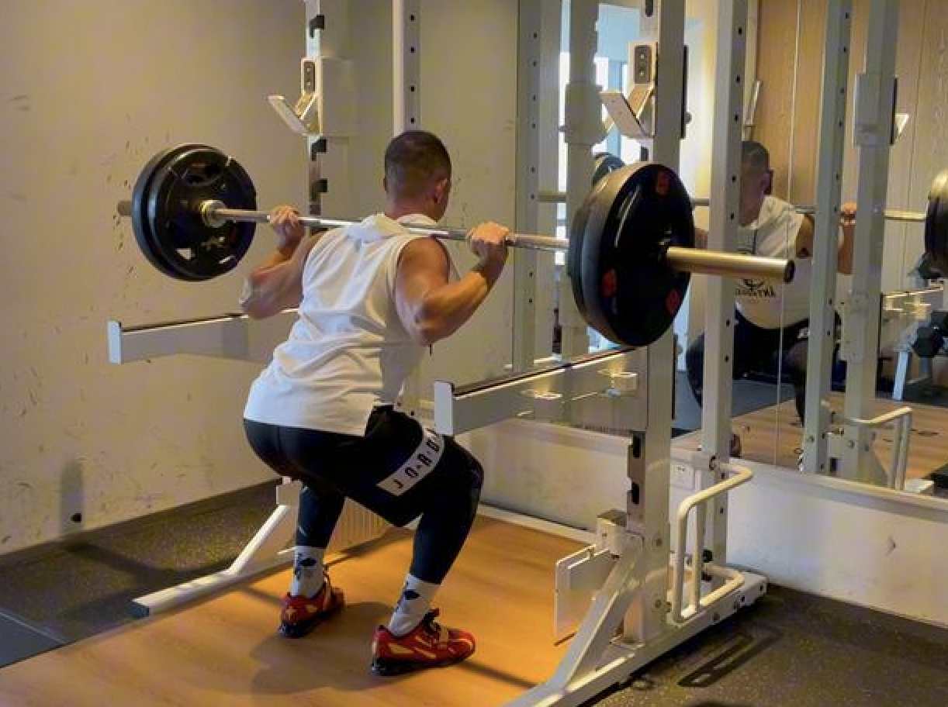
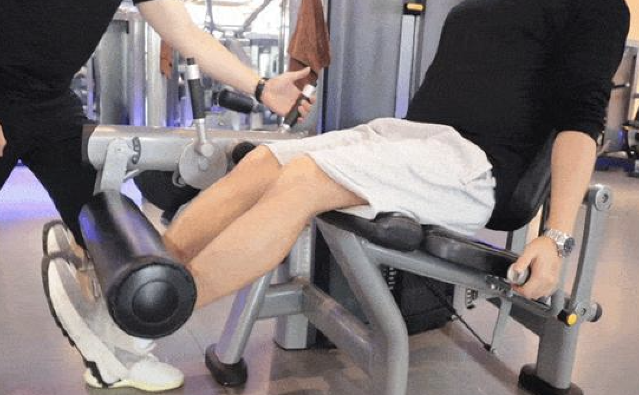
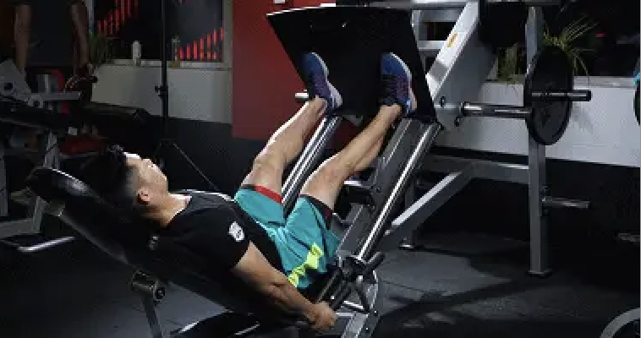
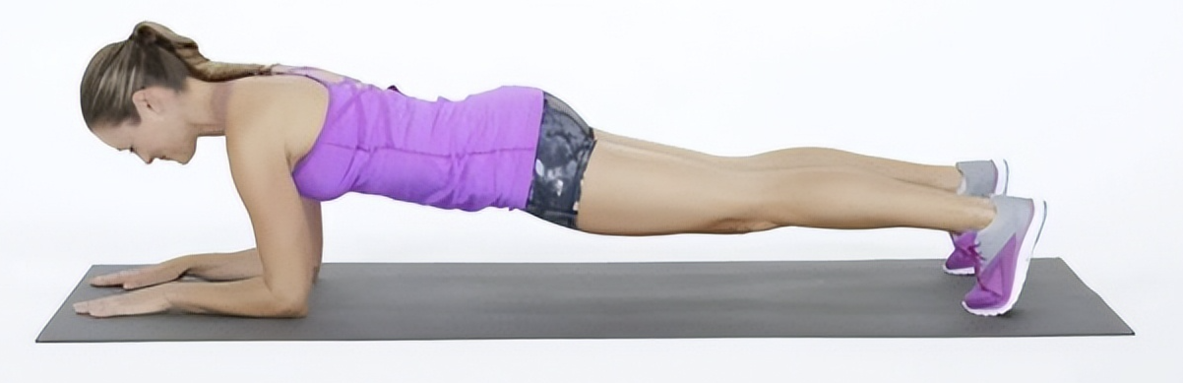

Movement Supervision & Gesture Correction
11.Barbell Squat
12.Leg Extension Machine
13.Leg Press
14.Plank
15.Sit-up
Data available & Technical approach

Slide 28
Movement Supervision & Gesture Correction
Source of the dataset
Bing, Baidu, Google and other platforms.
Some videos are still being taken by myself.
Data available & Technical approach

Slide 29
Movement Supervision & Gesture Correction
10 videos/posture 2 correct + 8 incorrect
3.5 seconds/video 4k
Frame-by-Frame Analysis
Incorrect Postures Labels:
Head Offset Left Hand Too Far Left
Left Hand Too Far Right Right Hand Too Far Left
Left Arm Not Fully Extended Right Arm Not Fully Extended
Left Arm Insufficiently Bent Right Arm Insufficiently Bent
Left Leg Insufficiently Bent Right Leg Insufficiently Bent
Left Leg Not Fully Extended Right Leg Not Fully Extended
Insufficient Abdominal Curvature HeadHips Too High
Data available & Technical approach

Slide 30
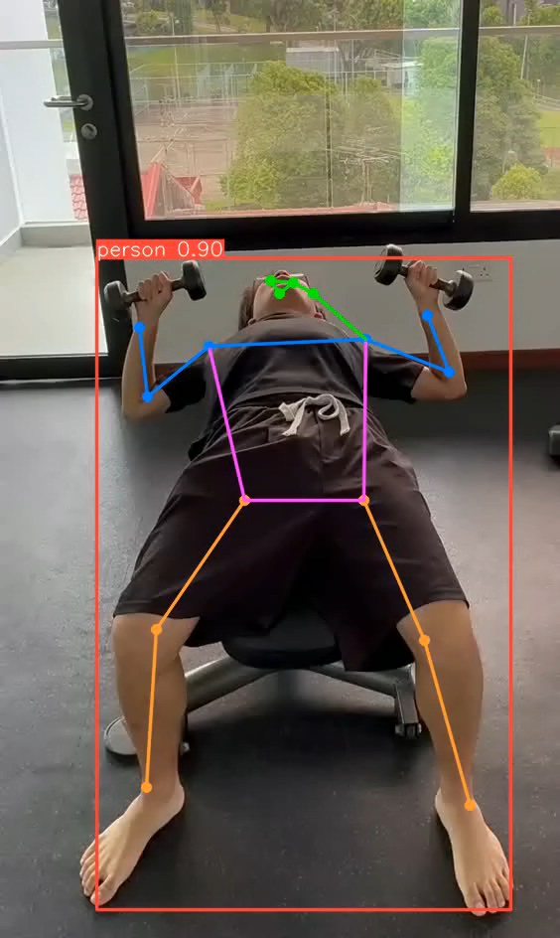
Movement Supervision & Gesture Correction
Detection of the keypoints
YOLOv8-pose
Use Euclidean distance to determine whether key points are within the threshold to assess if the movement is correct.
Data available & Technical approach

Slide 31
Movement Supervision & Gesture Correction
Training model: CNN+KNN
CNN:convolution + pooling + convolution + pooling + convolution + pooling + fully connected layers ReLu/sigmoid
This structure extracts key point location features and motion features
KNN: determine the specific category
Data available & Technical approach

Slide 32
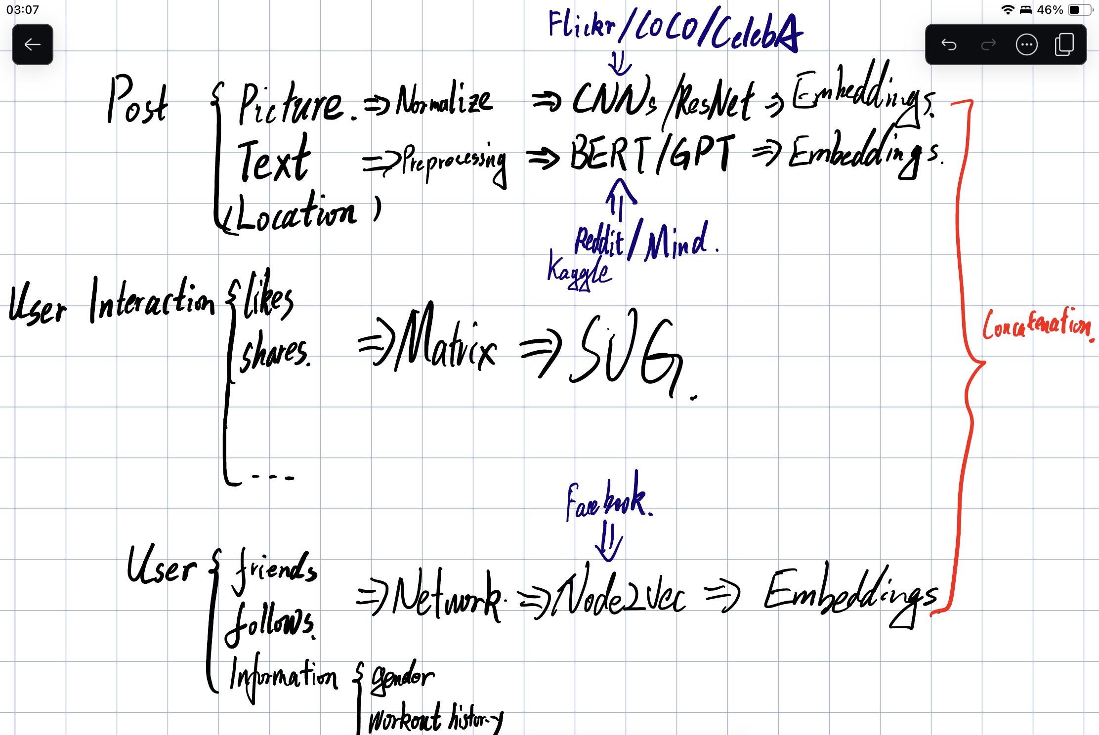
Social Media Integration AI-based recommendations
Data available & Technical approach

Slide 33
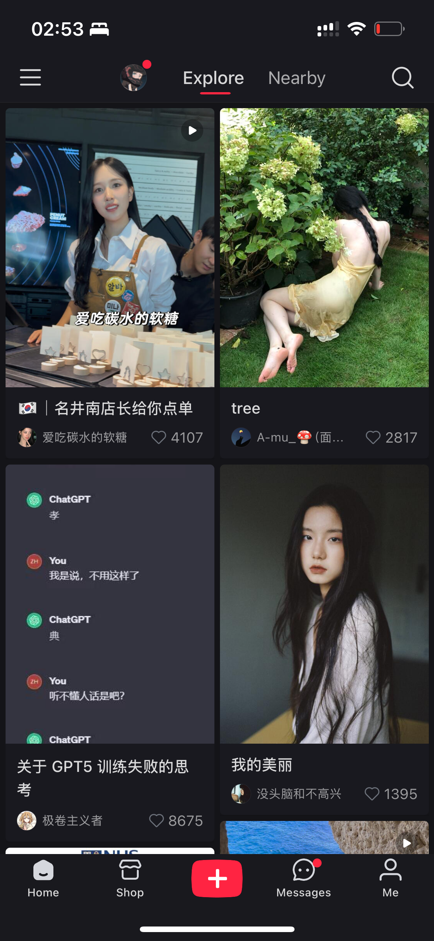
Social Media Integration AI-based recommendations
Xiaohongshu’s recommendation algorithm has been lauded for years
Data available & Technical approach
Notes:
Let's take a look at what other social platforms are doing first

Slide 34

Social Media Integration AI-based recommendations
Picture
Text
Likes
Shares
Comments
Following
Data available & Technical approach

Slide 35
Social Media Integration AI-based recommendations
Post
Picture
Text
Likes
Shares
Comments
Following
Interaction
User
Data available & Technical approach
Notes:
These attributes can be boiled down to three parts

Slide 36
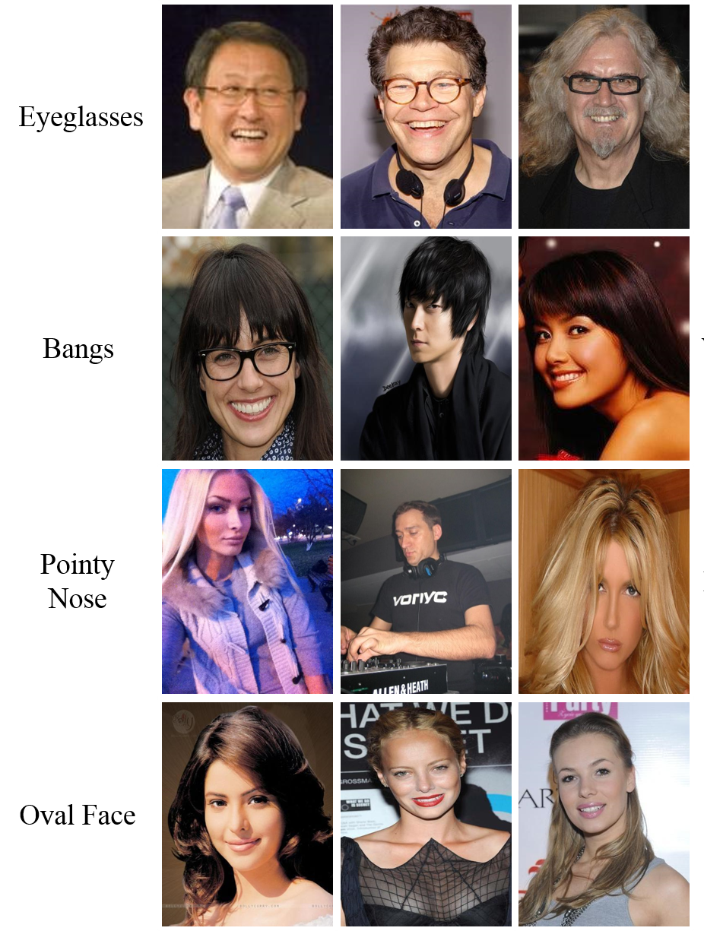
Social Media Integration AI-based recommendations
Post
Picture <= CIFAR-10/COCO/CelebA
Text <= Reddit/Microsoft News Dataset
Likes <= MovieLens/Amazon reviews
Shares <= MovieLens/Amazon reviews
Comments <= Reddit/ Microsoft News Dataset
Following <= Facebook social networks/Cora
Interaction
User
Data available & Technical approach
Notes:
Most posts are selfie

Slide 37
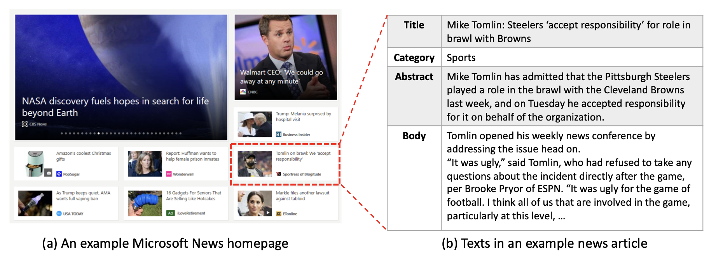
Social Media Integration AI-based recommendations
Post
Picture <= CIFAR-10/COCO/CelebA
Text <= Reddit/Microsoft News Dataset
Likes <= MovieLens/Amazon reviews
Shares <= MovieLens/Amazon reviews
Comments <= Reddit/ Microsoft News Dataset
Following <= Facebook social networks/Cora
Interaction
User
Data available & Technical approach
Notes:
I found on github that Our seniors successfully completed model training with this dataset, which was a nusblog-related project

Slide 38
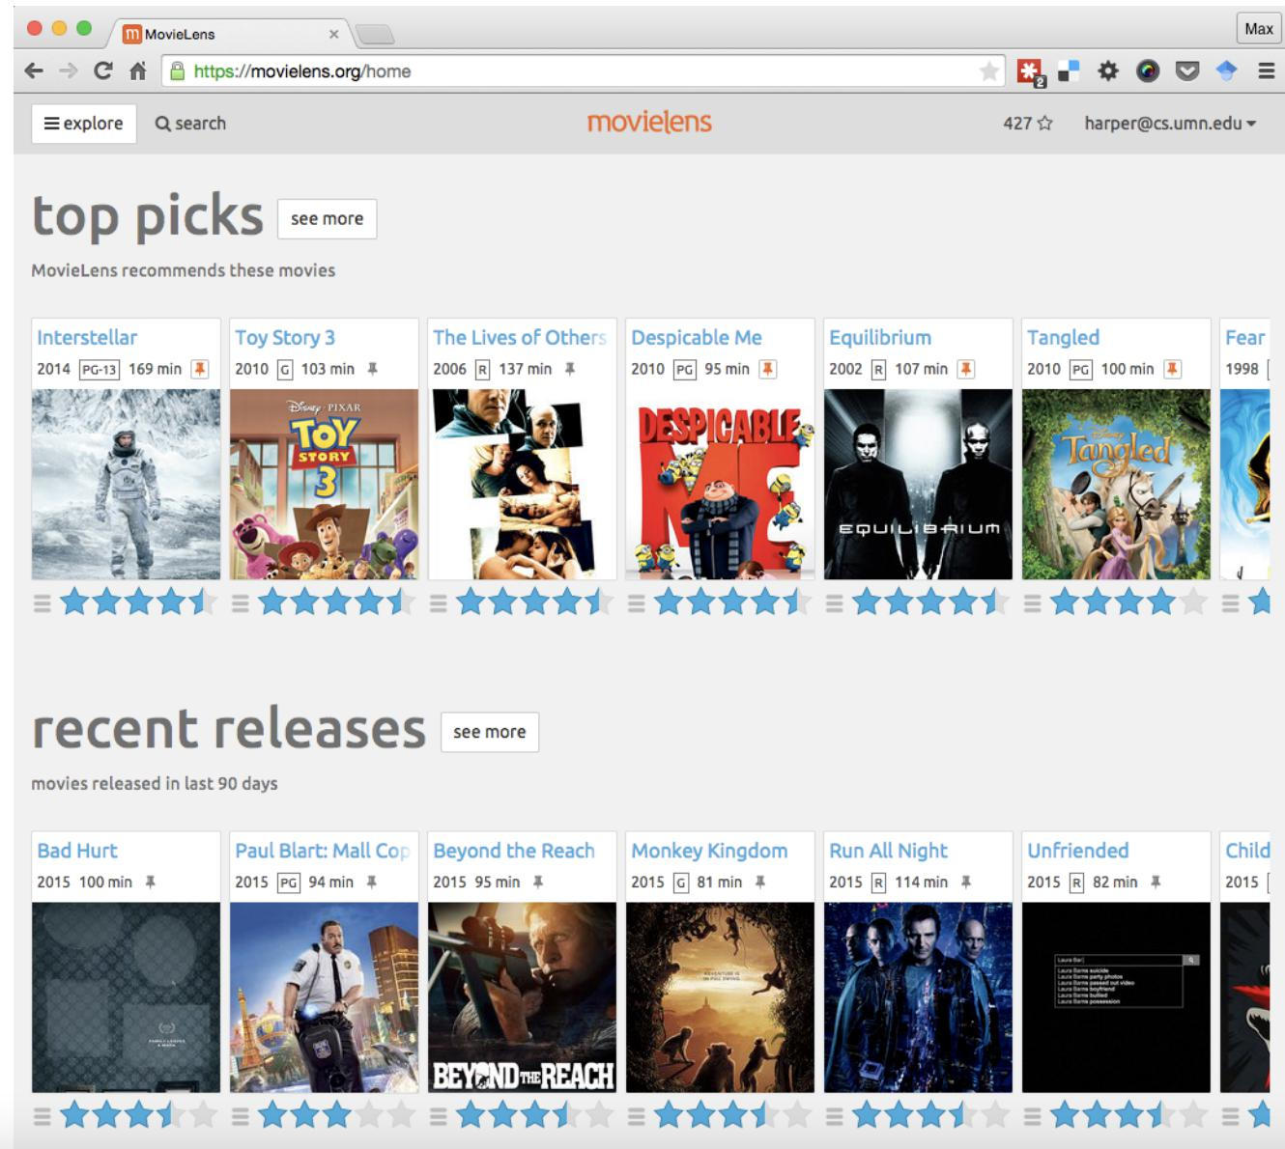
Social Media Integration AI-based recommendations
Post
Picture <= CIFAR-10/COCO/CelebA
Text <= Reddit/Microsoft News Dataset
Likes <= MovieLens/Amazon reviews
Shares <= MovieLens/Amazon reviews
Comments <= Reddit/ Microsoft News Dataset
Following <= Facebook social networks/Cora
Interaction
User
Data available & Technical approach

Slide 39
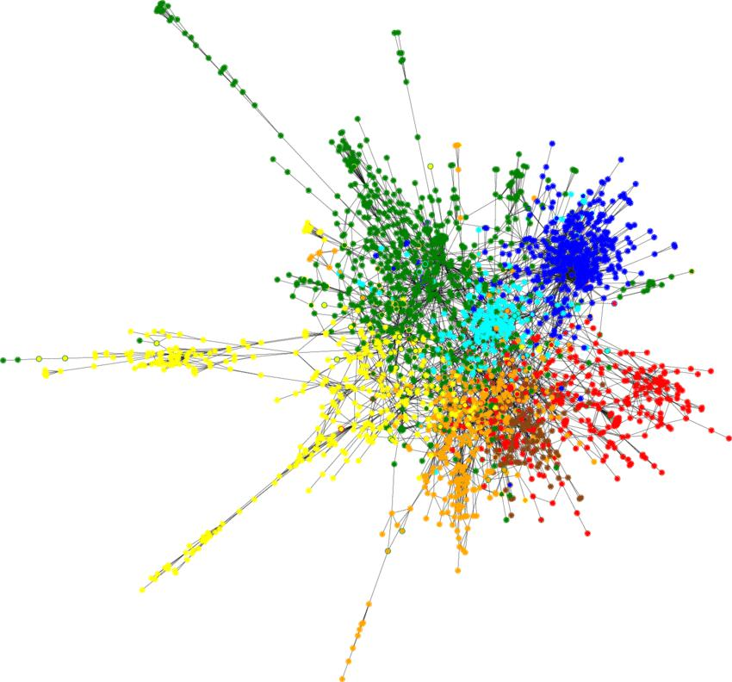
Social Media Integration AI-based recommendations
Post
Picture <= CIFAR-10/COCO/CelebA
Text <= Reddit/Microsoft News Dataset
Likes <= MovieLens/Amazon reviews
Shares <= MovieLens/Amazon reviews
Comments <= Reddit/ Microsoft News Dataset
Following <= Facebook social networks/Cora
Interaction
User
Data available & Technical approach

Slide 40
Hybrid Recommendation Systems
Data
Preprocessing
Algorithm
Feature vectors
Fusion layer
Picture
Normalize..
CNNs/ResNet
Embeddings
Post
Title & Text
Stop words..
Fastformer/GPTs
Embeddings
Location
Location
Likes
Concatenation
Interaction
Shares
Build Matrix
SVD/ALS
Latent factors
Comments
Stop words..
BERT/GPTs
Embeddings
Friends
Build user-user & user-post graph
Node2Vec/LINE
Embeddings
User
Follows
Information
One-hot tok
Information
Data available & Technical approach

Slide 41
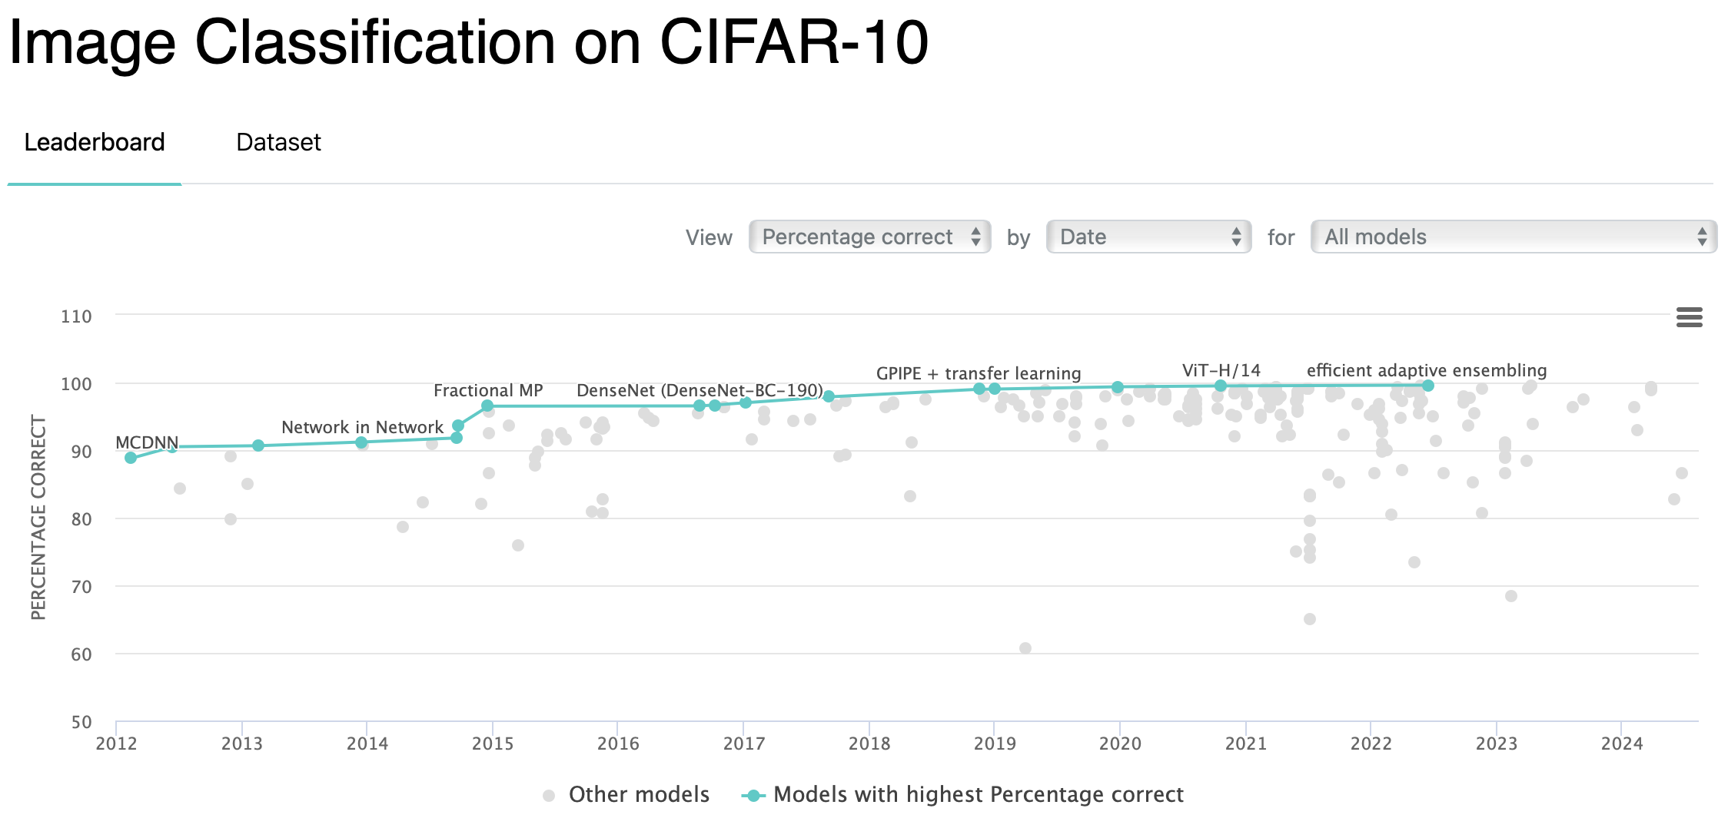
Social Media Integration AI-based recommendations
Data available & Technical approach

Slide 42
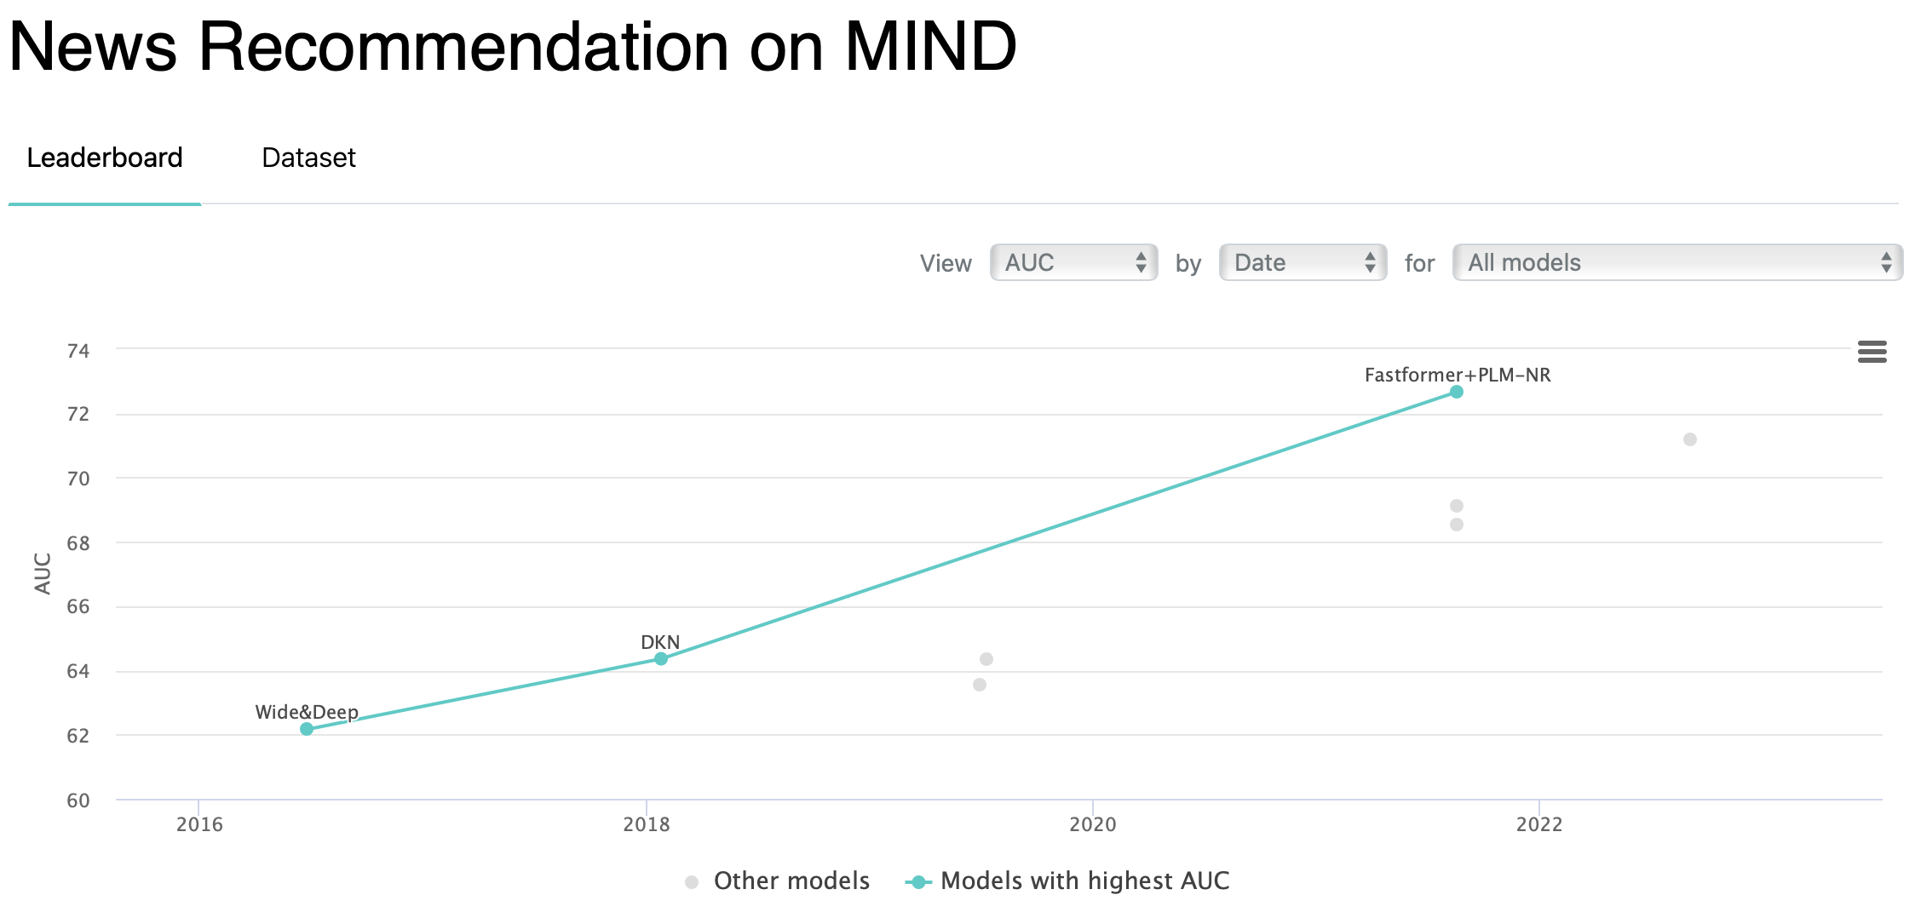
Social Media Integration AI-based recommendations
Data available & Technical approach

Slide 43
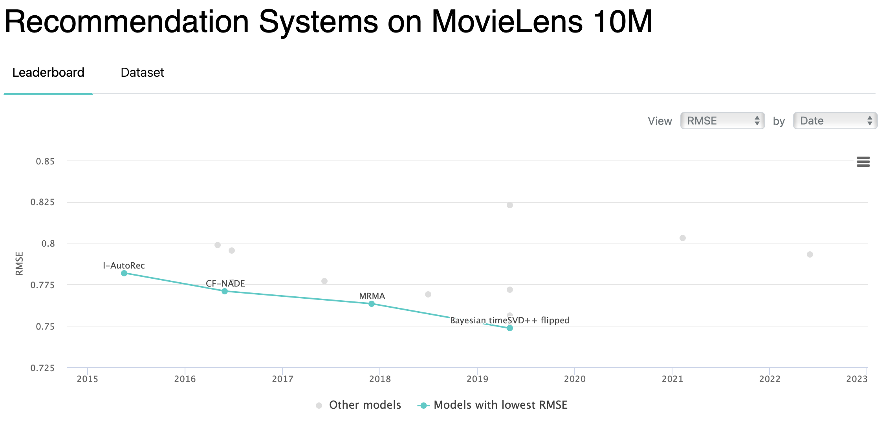
Social Media Integration AI-based recommendations
Data available & Technical approach

Slide 44
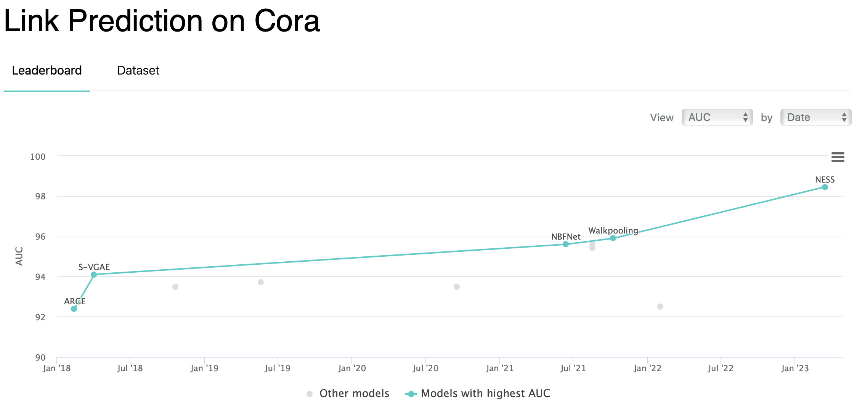
Social Media Integration AI-based recommendations
Data available & Technical approach

Slide 45
Hybrid Recommendation Systems
Data
Preprocessing
Algorithm
Feature vectors
Fusion layer
Picture
Normalize..
CNNs/ResNet
Embeddings
Post
Title & Text
Stop words..
Fastformer/GPTs
Embeddings
Location
Location
Likes
Concatenation
Interaction
Shares
Build Matrix
SVD/ALS
Latent factors
Comments
Stop words..
BERT/GPTs
Embeddings
Friends
Build user-user & user-post graph
Node2Vec/LINE
Embeddings
User
Follows
Information
One-hot tok
Information
Data available & Technical approach
Notes:
By training these models on the appropriate datasets, we can create a powerful multimodal recommendation system that takes into account text, images, user interactions, and graph structures to provide highly personalized recommendations.

Slide 46
What we have done so far
What we have done so far
Notes:
We have basically finished the ui design, completed the algorithm selection, and prepared the training dataset source

Slide 47
timeline
Day 0: Project Setup and Planning
Finalize project scope, define key features (gym recommendations, workout plans, Movement Supervision and Gesture Correction, social media).
Set up the development environment (front-end with Vue, back-end with Python/Flask, database with MySQL).
Assign tasks and define responsibilities for team members (front-end, back-end, database, testing).
Day 1-4: Focus on AI Model Planning and Initial Implementation
AI-Powered Features:
Gym and Workout Site Recommendation (location-based services)
Post Recommendation System: Analyse user behaviour and content preferences to suggest relevant posts.
Friend Recommendation System: Suggest friends based on shared interests, social engagement, or workout habits.
Workout Plan Recommendations: Suggest personalized workouts using AI based on past workouts, goals, and preferences.
Real-Time Feedback System: Use computer vision for workout form correction (e.g., posture during squats, push-ups).
Model and Algorithm Selection
Set Up Development Environment
Data Collection & Preprocessing
What we have done so far

Slide 48
timeline
Day 5-7: Core Feature Implementation
Front-end: Basic UI/UX for the main app screens (user profile, gym recommendations, workout plan display) using Swift.
Back-end: Implement basic API endpoints for user registration, login, and profile management using Python.
Database: Set up user data storage, gym locations, and workout plans using MySQL.
Achieve the first version of the user interface, allowing users to interact with the core functionalities like gym and workout recommendations.
Day 8: Location-Based Services
Day 9-10: Social Media Integration
Day 10-11: AI-Powered Recommendations
Day 12-13: AI-Powered Real-Time Feedback
Day 14: Testing and Refinement
What we have done so far

Slide 49
THE END

